Slide 1
INDUSTRY PROJECT ERASMUS+ 2016-2019

Slide 2
Mini Maritsa iztok (MMI) operates the largest open pit lignite coal mine in the country and sells to four thermal power plants, including TPP Maritsa East 2, all of them located in the Maritsa-East complex. MMI produces all of the coal briquettes and over 90% of the coal required for the thermal power plant energy production in Bulgaria. The electric power generated within the Maritsa-East complex accounts for more than 25% of the total electricity power generation in Bulgaria.
The production area of the coal mine is approximately 240 square kilometres and it has reserves of 2 096 million tonnes. The maximum extraction capacity of the mine is 35 million tonnes annually. MMI's coal reserves are expected to be sufficient to service the current usage for a period of between 60 and 70 years.
MMI operates under a 35-year concession granted by the Bulgarian government in July 2008.

Slide 3
The production area of the coal mine is approximately 240 square kilometres and it has reserves of 2 096 million tonnes. The maximum extraction capacity of the mine is 35 million tonnes annually. MMI's coal reserves are expected to be sufficient to service the current usage for a period of between 60 and 70 years.
MMI operates under a 35-year concession granted by the Bulgarian government in July 2008.

Slide 4
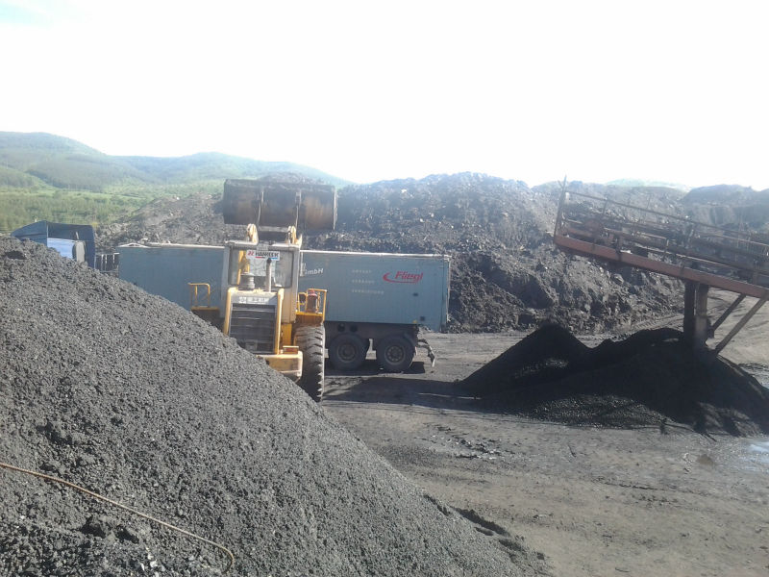
Proc. of International Energy Raw Materials and Energy Summit, Istanbul, Turkey 1-3, October, 2015 BULGARIAN COAL INDUSTRY REVIEW I. Nishkov, I. Grigorova, S. Stoev University of Mining and Geology “St. Ivan Rilski, Department of Mineral Processing and Recycling, 1700 Sofia, Bulgaria ABSTRACT. The paper discusses Bulgarian coal deposits, reserves, mining and some aspects of Bulgarian energy policy. Coal has a large important for Bulgaria's economy - as coal-fired power plants produce about 45% of the country's energy. Bulgaria has extensive deposits of coal, mostly lignite. Coal plays a vital role in power generation and this role is set to continue. Coal currently fuels 39% of the world’s electricity and this proportion is expected to remain at similar levels over the next 30 years. The Bulgarian coal industry is reviewed. 1. Bulgarian Coal Mining Coal is an important energy resource primarily used for electricity generation around the world. The coal resource is a critical substance in many industries to fulfill the needs as energy source, raw materials in steel making and high temperature electrode for aluminum industry, for example (World Energy Resources, Coal World Energy Council 2013).

Slide 5
Theoretical coal reserves on the territory of the Republic of Bulgaria amount to approximately 2 billion tonnes, of which slightly more than 1.7 billion tonnes are currently being exploited. Lignite coal is dominant, comprising 93% of the coal mix, followed by brown coal (7%) and black coal (0.02%). Geologic exploration has identified about 43 coal basins.

Slide 6
The reserves of anthracite are slightly more than 1.2 billion tons but more than 95% of
these are located in the Dobruja Coal Basin at depth of some 1.5 km and at this stage cannot
be exploited.
Bulgarian coal production in 2014 is estimated at 31.3 million tonnes, which is 9.4%
more compared to 2013

