Slide 1
5th Class Ms Ryan
Erasmus Project 2019-2020
Buildings

Slide 2
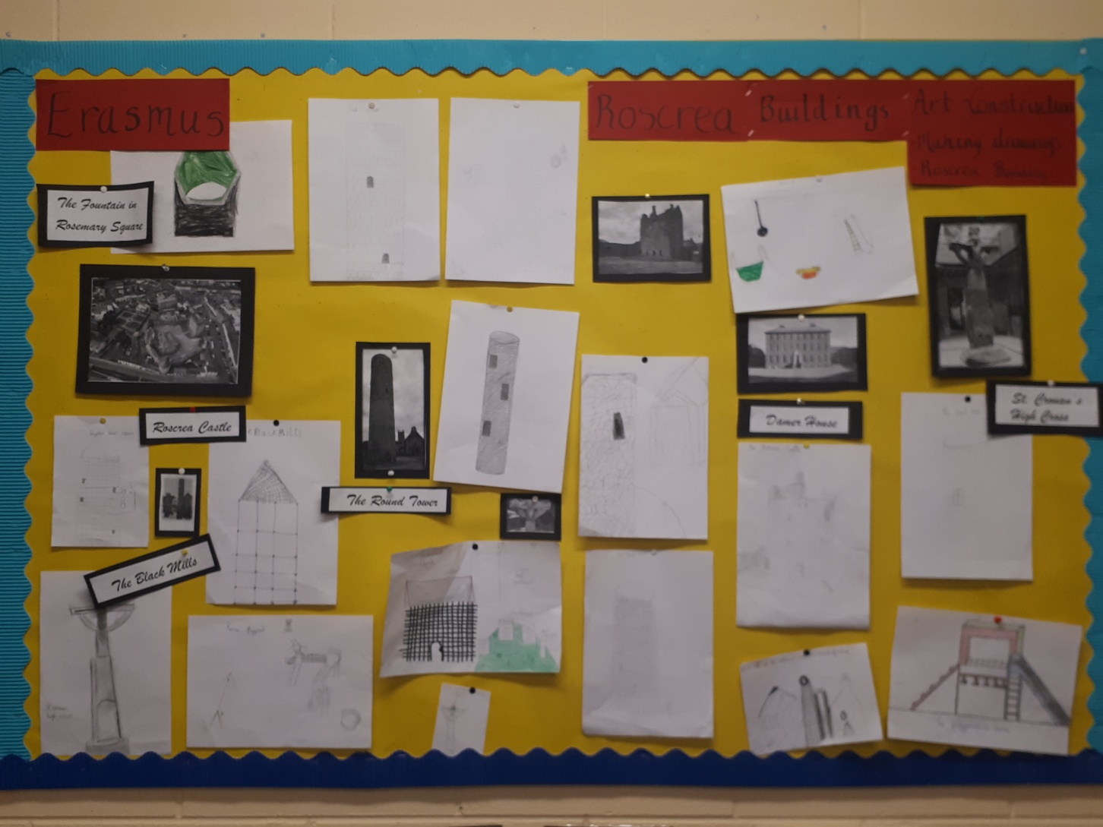
5th Class display of Buildings in Roscrea

Slide 3
Roscrea, Co. Tipperary
Roscrea is a heritage town. That means that there are many historical buildings to be seen.The Roscrea castle was built in the early thirteenth century. Roscrea is one of the oldest towns in Ireland.
There are lots of historical buildings in Roscrea.
For example the Round Tower, Churches, The High Cross , The Black Mills and Damer House. Roscrea Castle is in the centre of town.

Slide 4
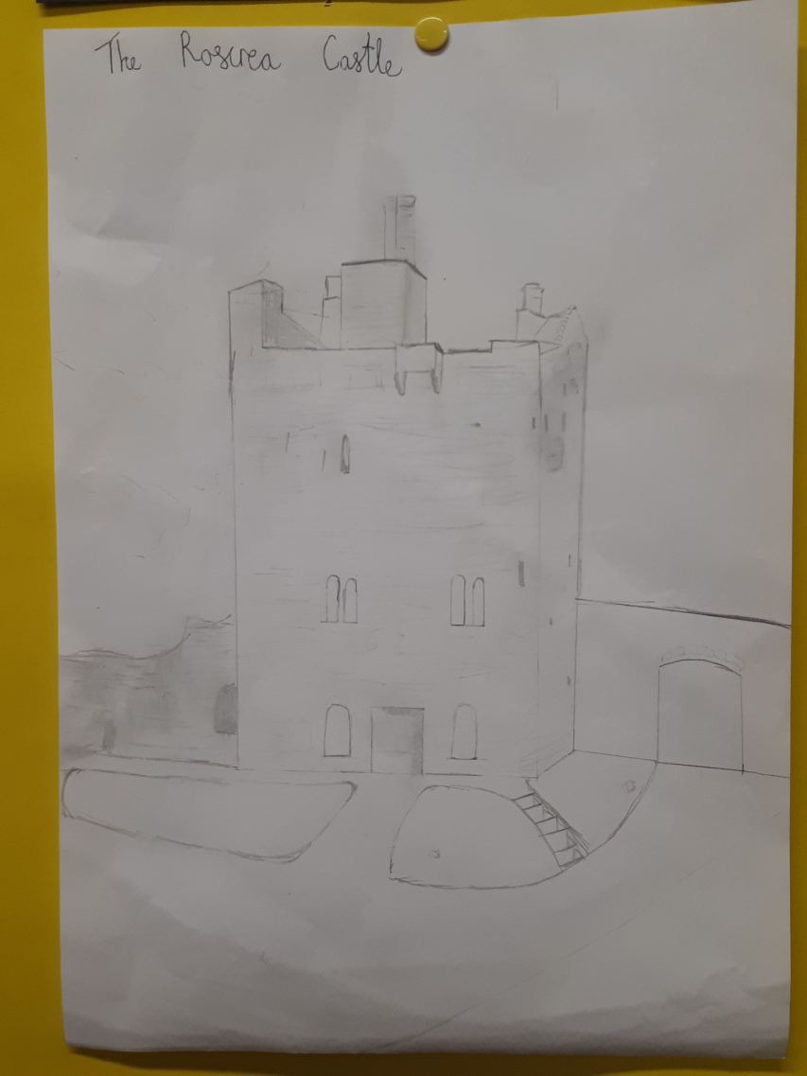
Local Buildings in Roscrea
Roscrea Castle- drawn by Kayla Mcnamara.
Roscrea Castle
The Round Tower
The Black Mills
Damer House
St Cronan’s High Cross (In the Black Mills)
The Fountain (In Rosemary square.)

Slide 5
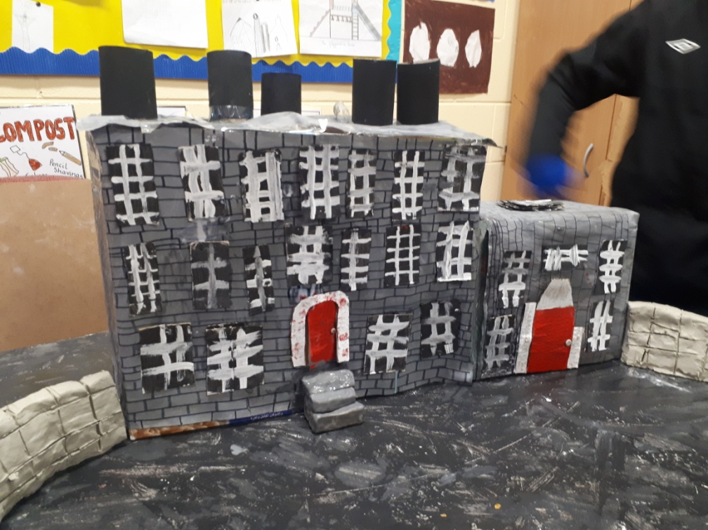
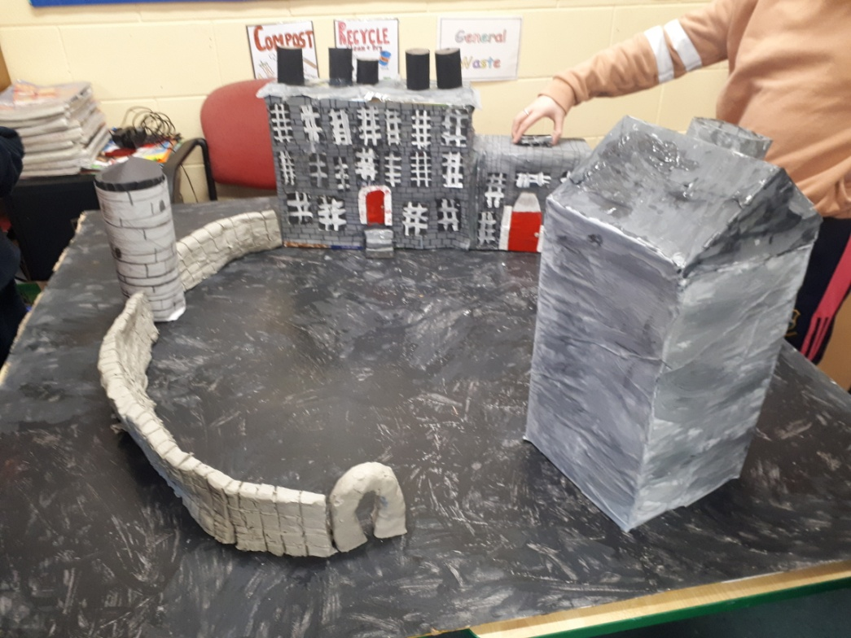
Roscrea castle and damer house

Slide 6
Damer House and the Roscrea Castle
Roscrea Castle is an amazing thirteenth century royal castle located in the heart of Roscrea. The castle grounds consist of a gate tower, curtain walls and two tower walls. The original wooden tower and motte were built on the orders of King John of England in 1213.
Today, Damer house can be found in the courtyard of Roscrea Castle. Built by Joseph Damer in the early eightheenth century, This sophisticated three story Queen Anne style house is an example of pre Palladian architectural design.There are exhibitions and guided tours,while visitors can also explore nearby St Cronans Church and Round Tower.

Slide 7
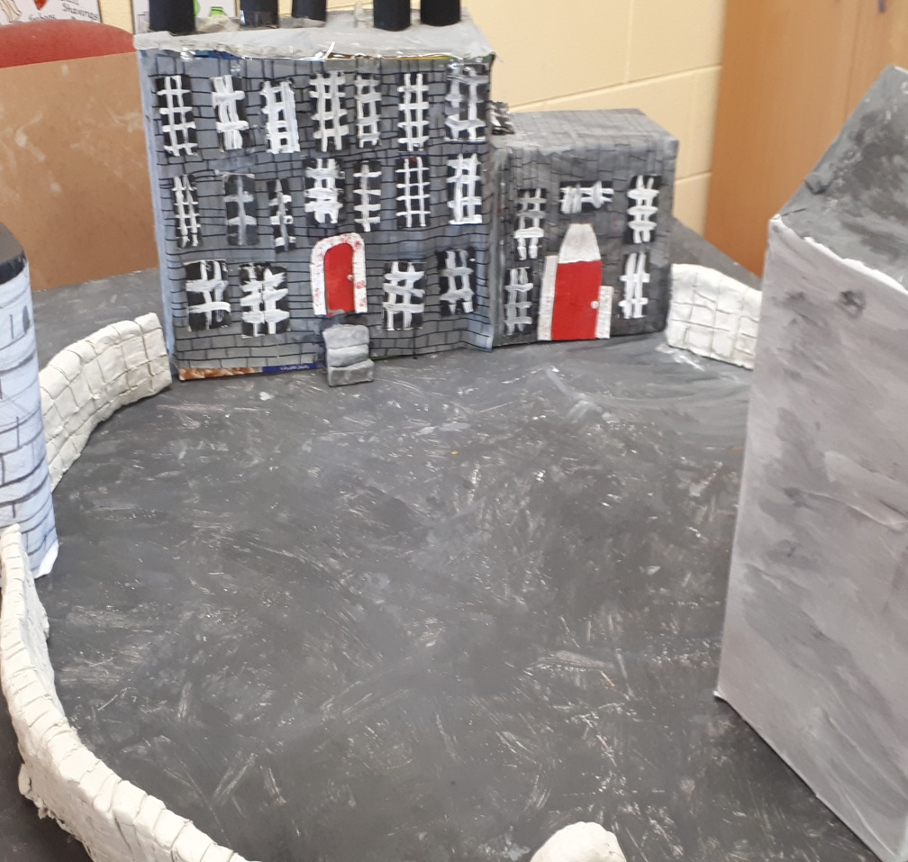
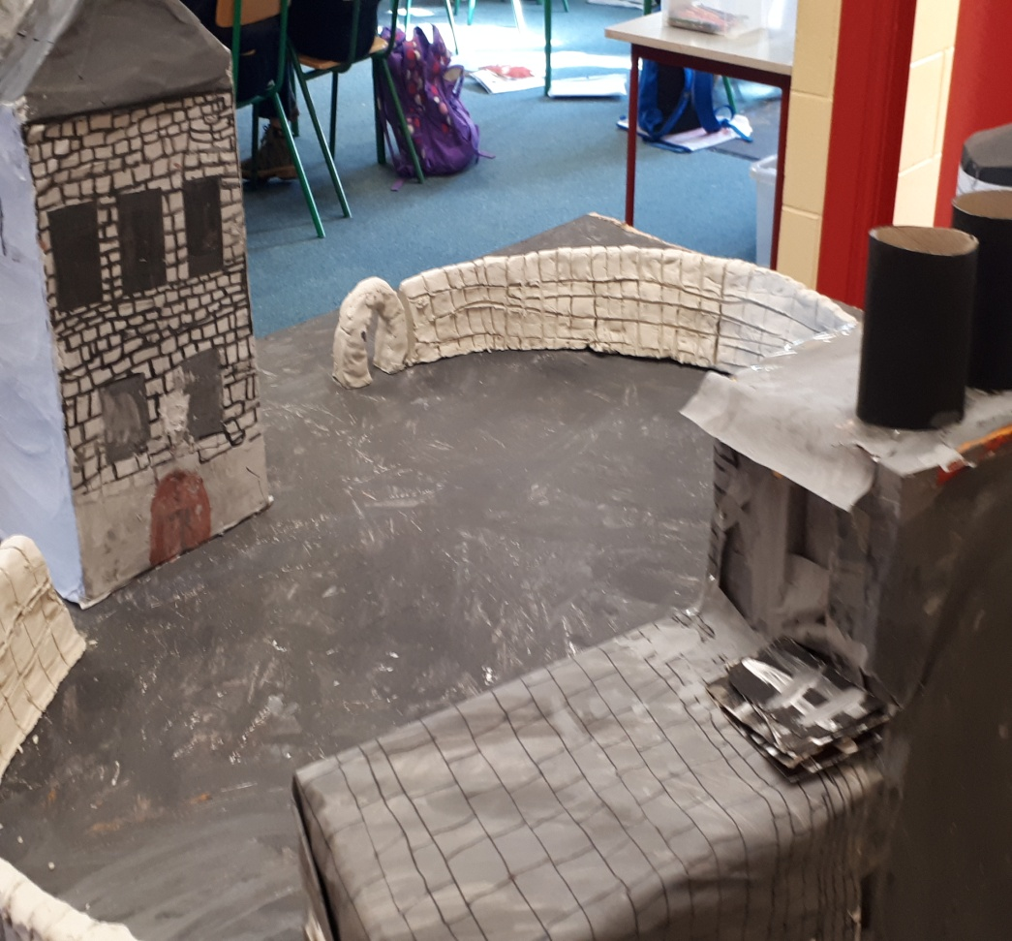
Damer House and Roscrea Castle

Slide 8
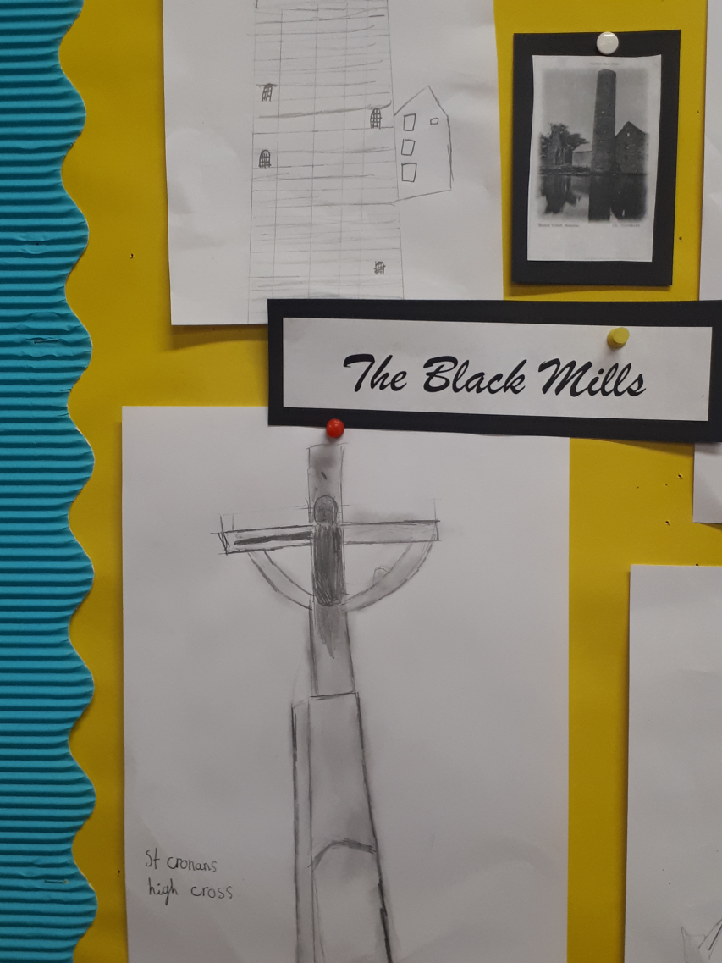
The Black Mills and St Cronan’s high cross
The Black Mills and St. Cronan’s High Cross.
ST. Cronan’s Cross is a fascinating relic that once sat in a nearby graveyard. It was restored and moved to the Black Mill in 2004.
The cross stands about 3m tall.
Across the road from The Black Mills visitors can also view St. Cronan’s Church.
It features different religious scenes, including the crucifixion of Jesus.

Slide 9
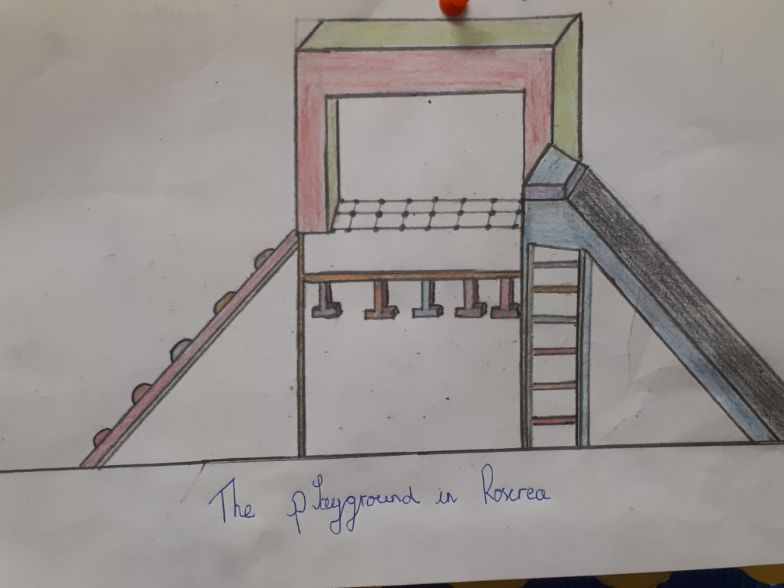
The Park and playground in Roscrea
Roscrea also has a town playground and park area where you can have a picnic on the green and play on the park equipment including a slide, swings and many more exciting things. There are lots of fairy doors to be seen too!

Slide 10
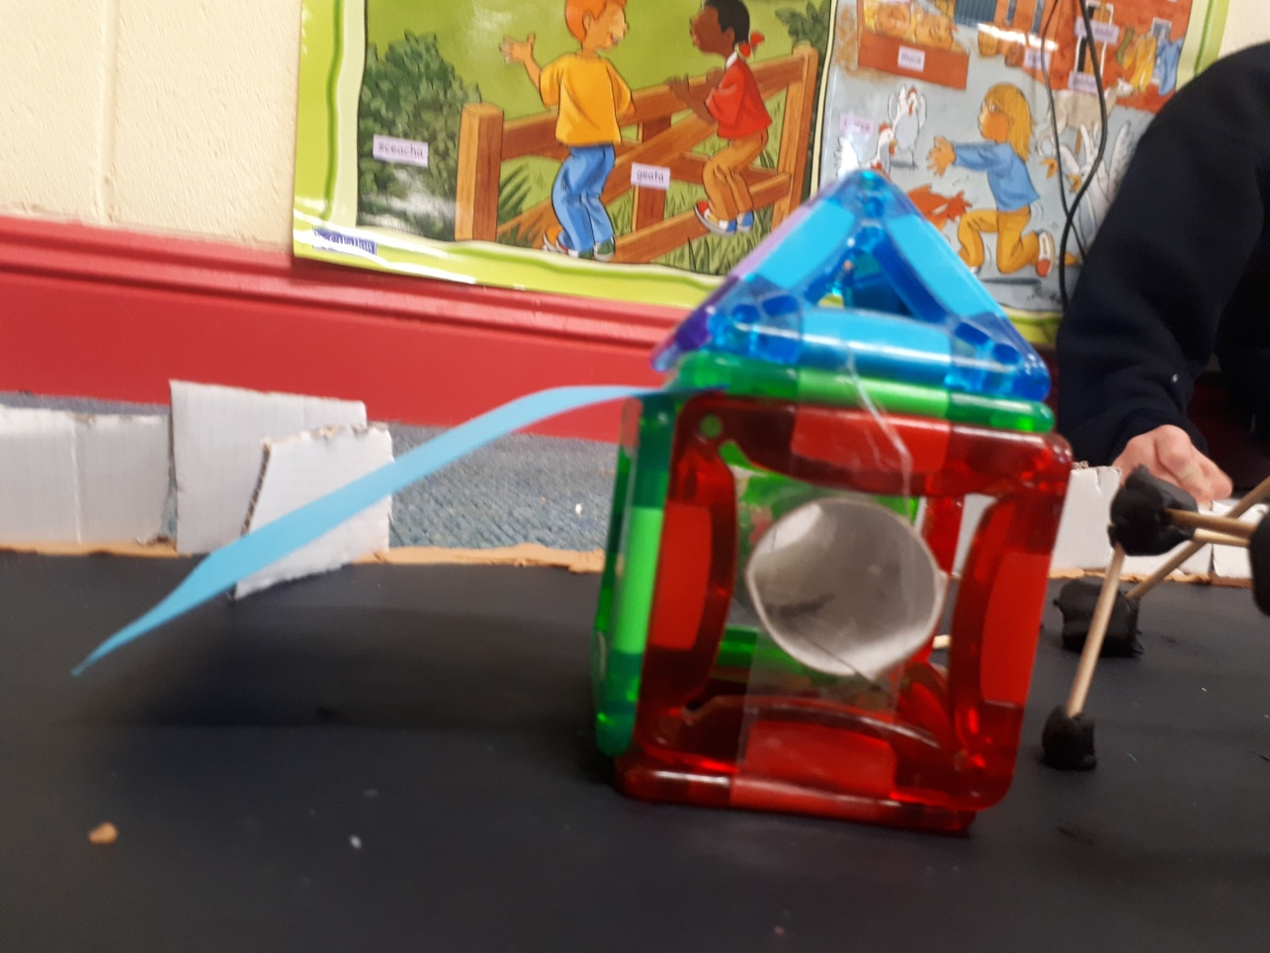
Our playground in Roscrea
When the boys were constructing the park they used lollipop sticks,magnets, cardboard and recyclables to make the playground equipment.

Slide 11
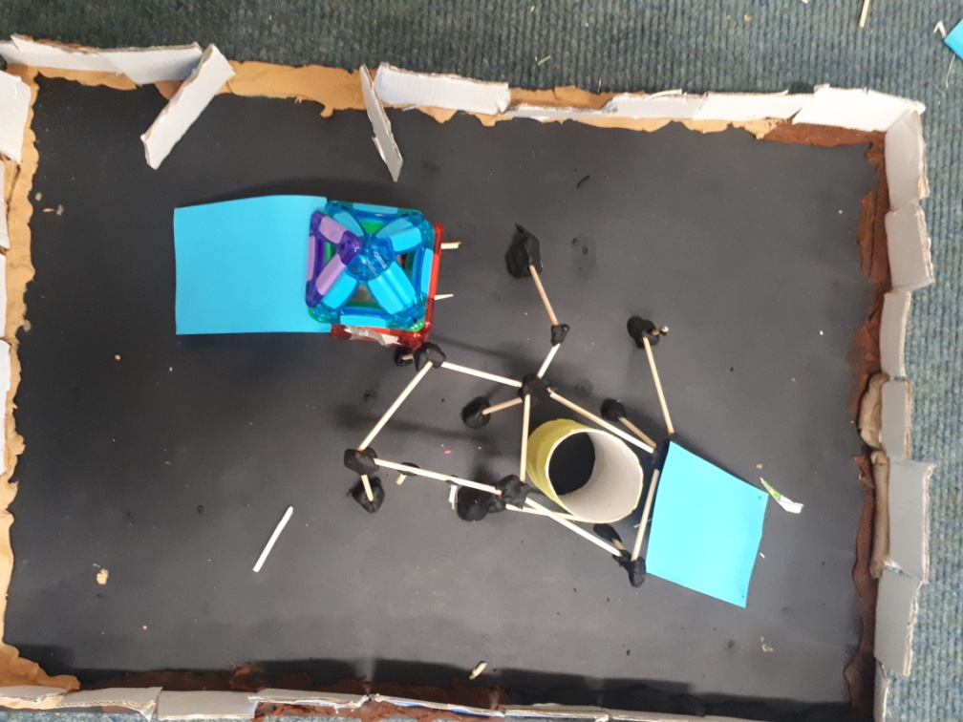
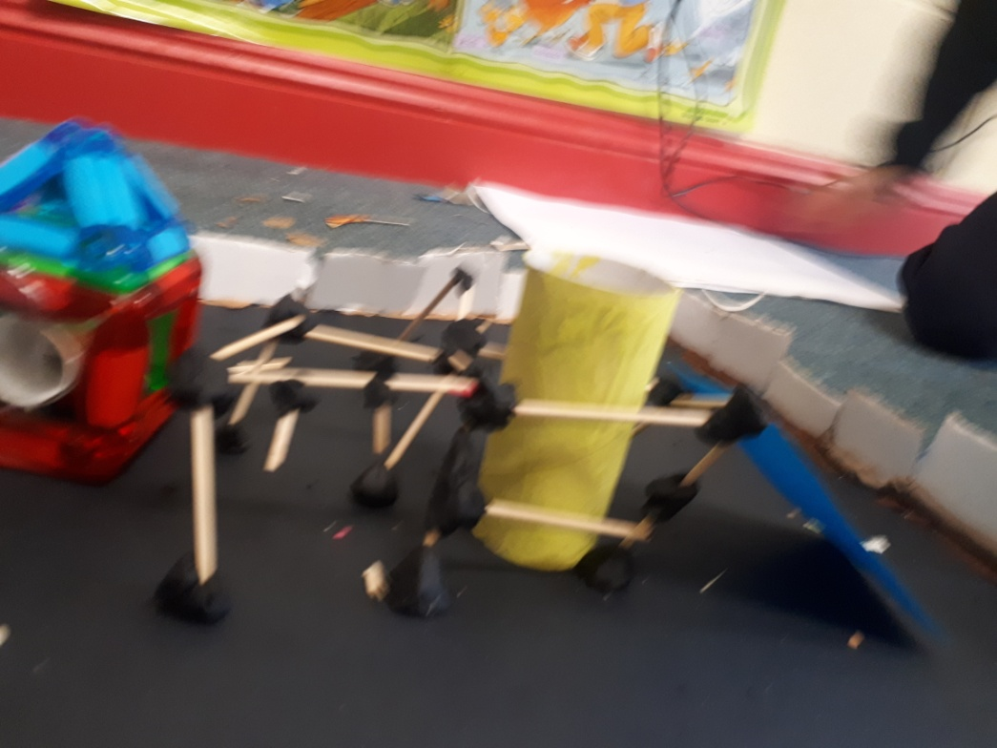
Our playground

Slide 12
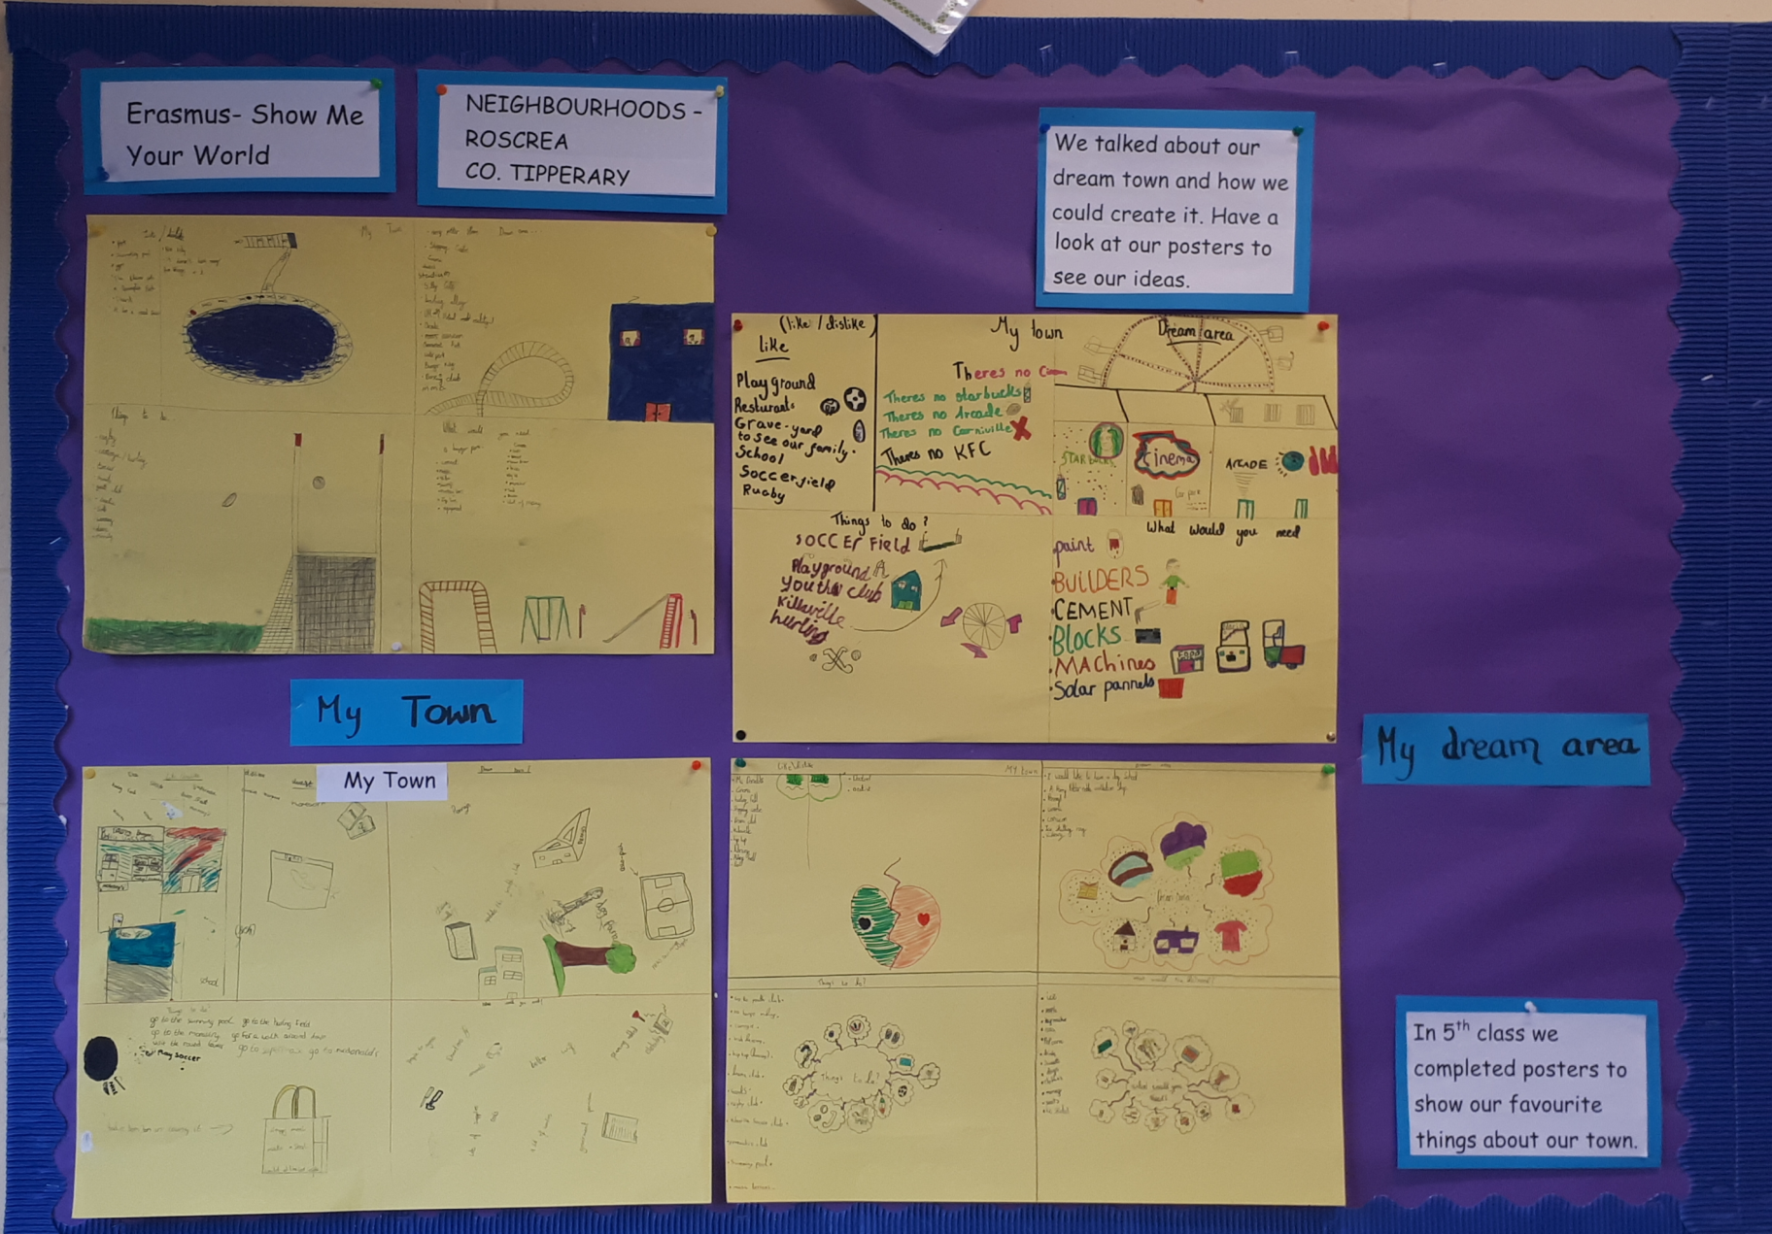
oUr Dream Town

Slide 13
Roscrea
In class we talked about all the things that we love about Roscrea.
Lots of us play rugby in the local rugby club, it’s one of our favourite things.
We use the local soccer club and hurling/ camogie clubs too.
Our local pool has a huge slide. It’s a great building. We love swimming.
Roscrea scouts and the youth club are an important part in our lives too.
We also have a fabulous golf club with a really nice restaurant

Slide 14
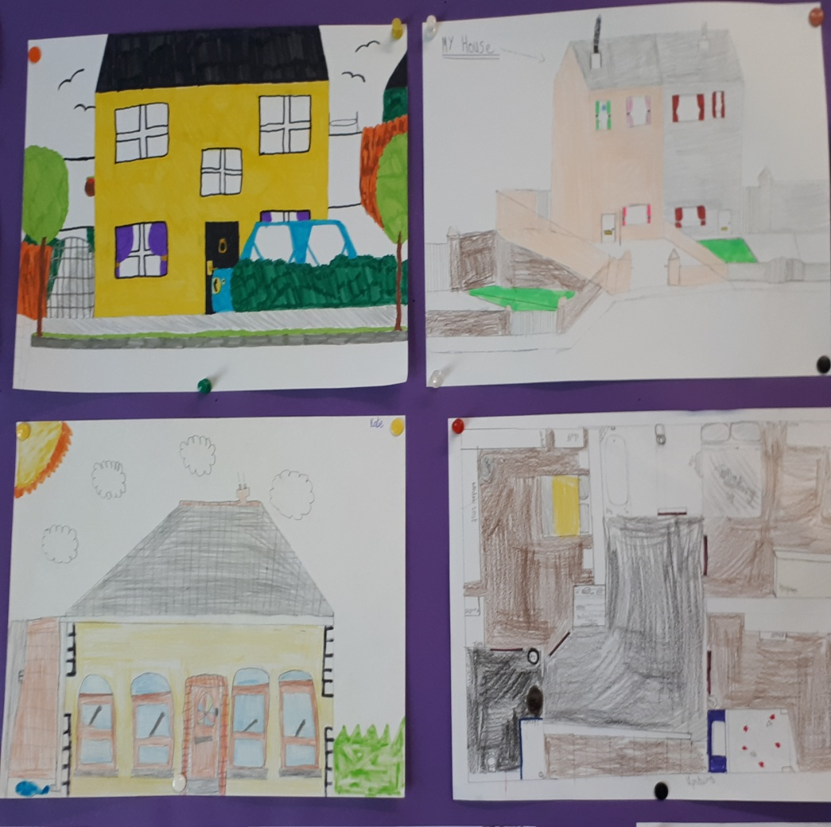
Typical types of homes and houses in our town.
There are lots of housing estates in Roscrea. These consist of bedrooms, kitchens, toilets and sitting rooms. There is a large variety of different houses like bungalow, two story houses, semi detached house and a detached houses in Roscrea.

Slide 15
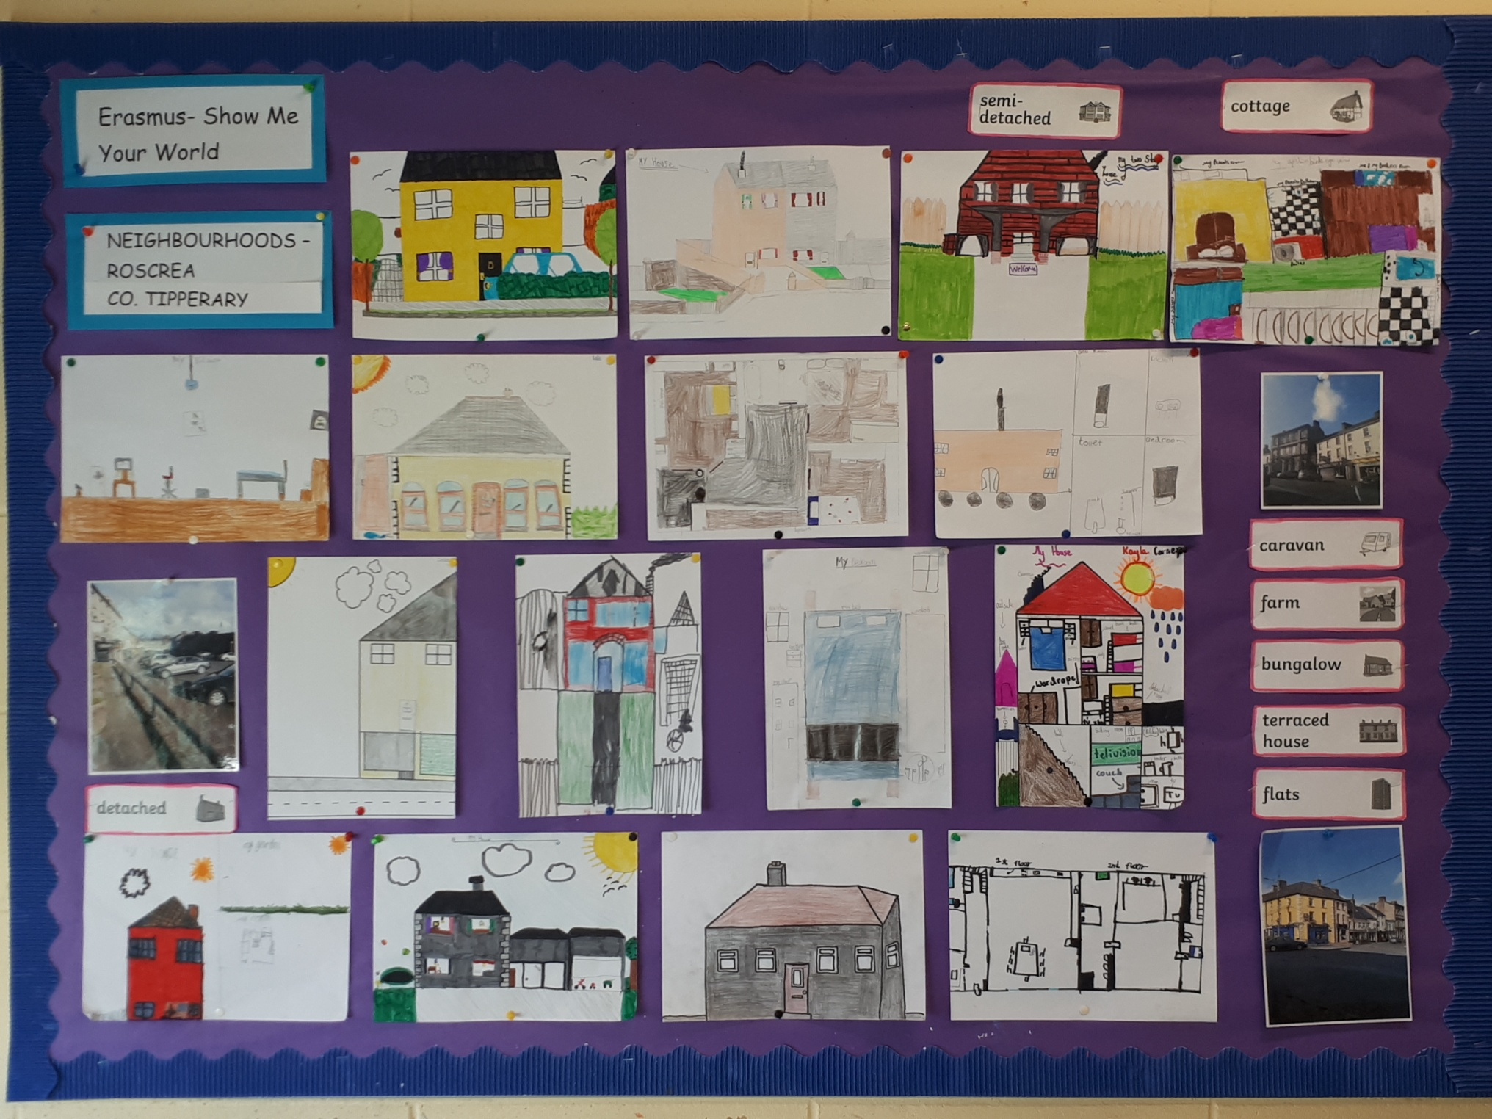

Slide 16
Our Town : Roscrea Co. Tipperary
We hope you enjoyed our presentation.
Thanks for listening!

