Slide 1
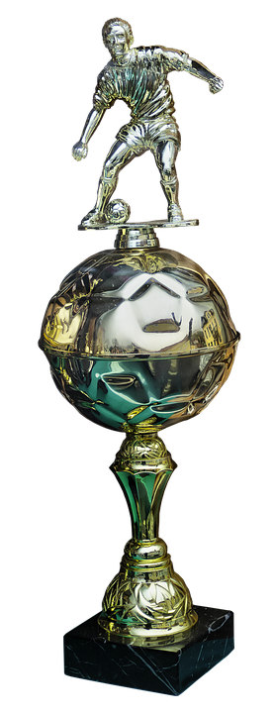
football
Dries, Younnes, Tess.

Slide 2
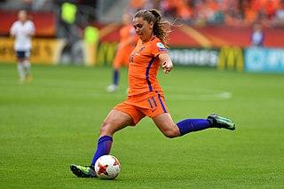
content
neecodig
team
clubs
matches

Slide 3
clubs as
Psv
Ajax
Feyenoord
Olympia
Liverpool
Fc barcelona

Slide 4
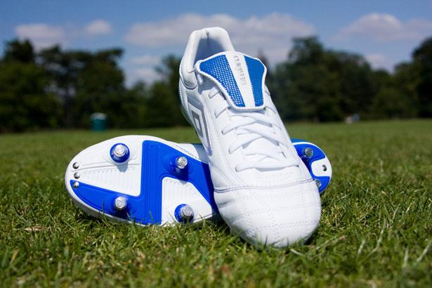
neecondig
bal
shin guards
socks
soccer shorts
soccer shirt
soccer shoes
gaol
lawn

Slide 5
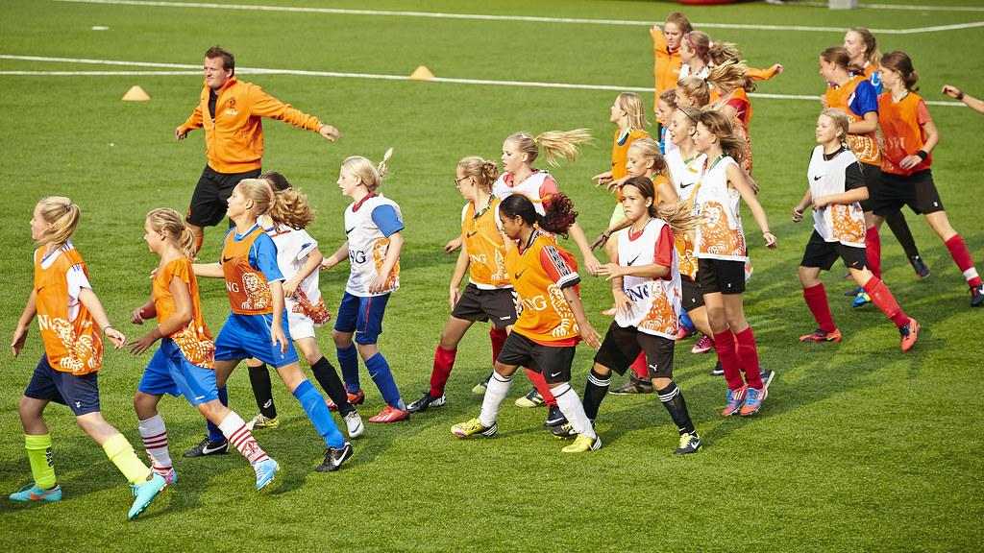
team
ceeper
attackers
deferenders
midfieler
rush hour
you train approximately 3a2
days + one hour each

Slide 6
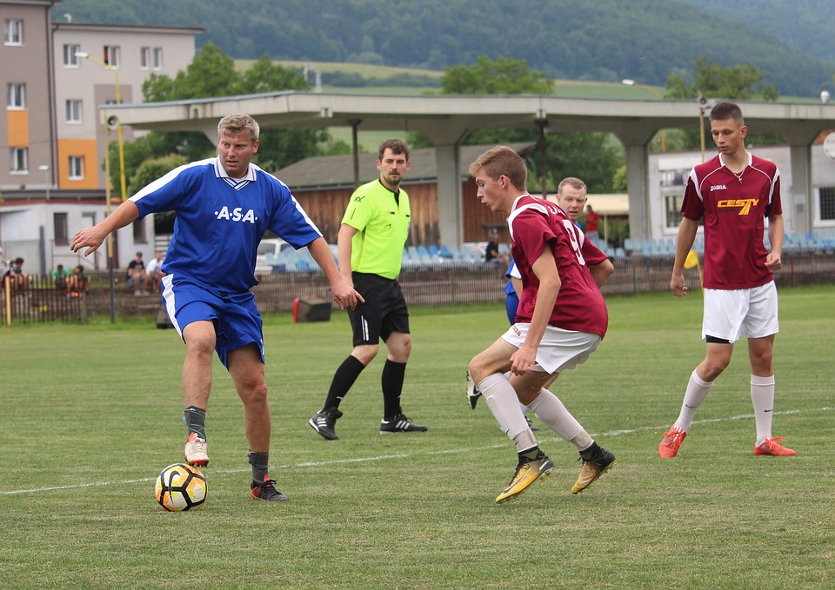
matches
lol
pleasure
winner
friends

Slide 7
the end

Slide 8
