Slide 1
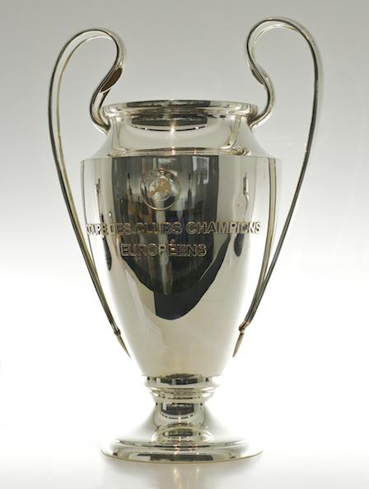
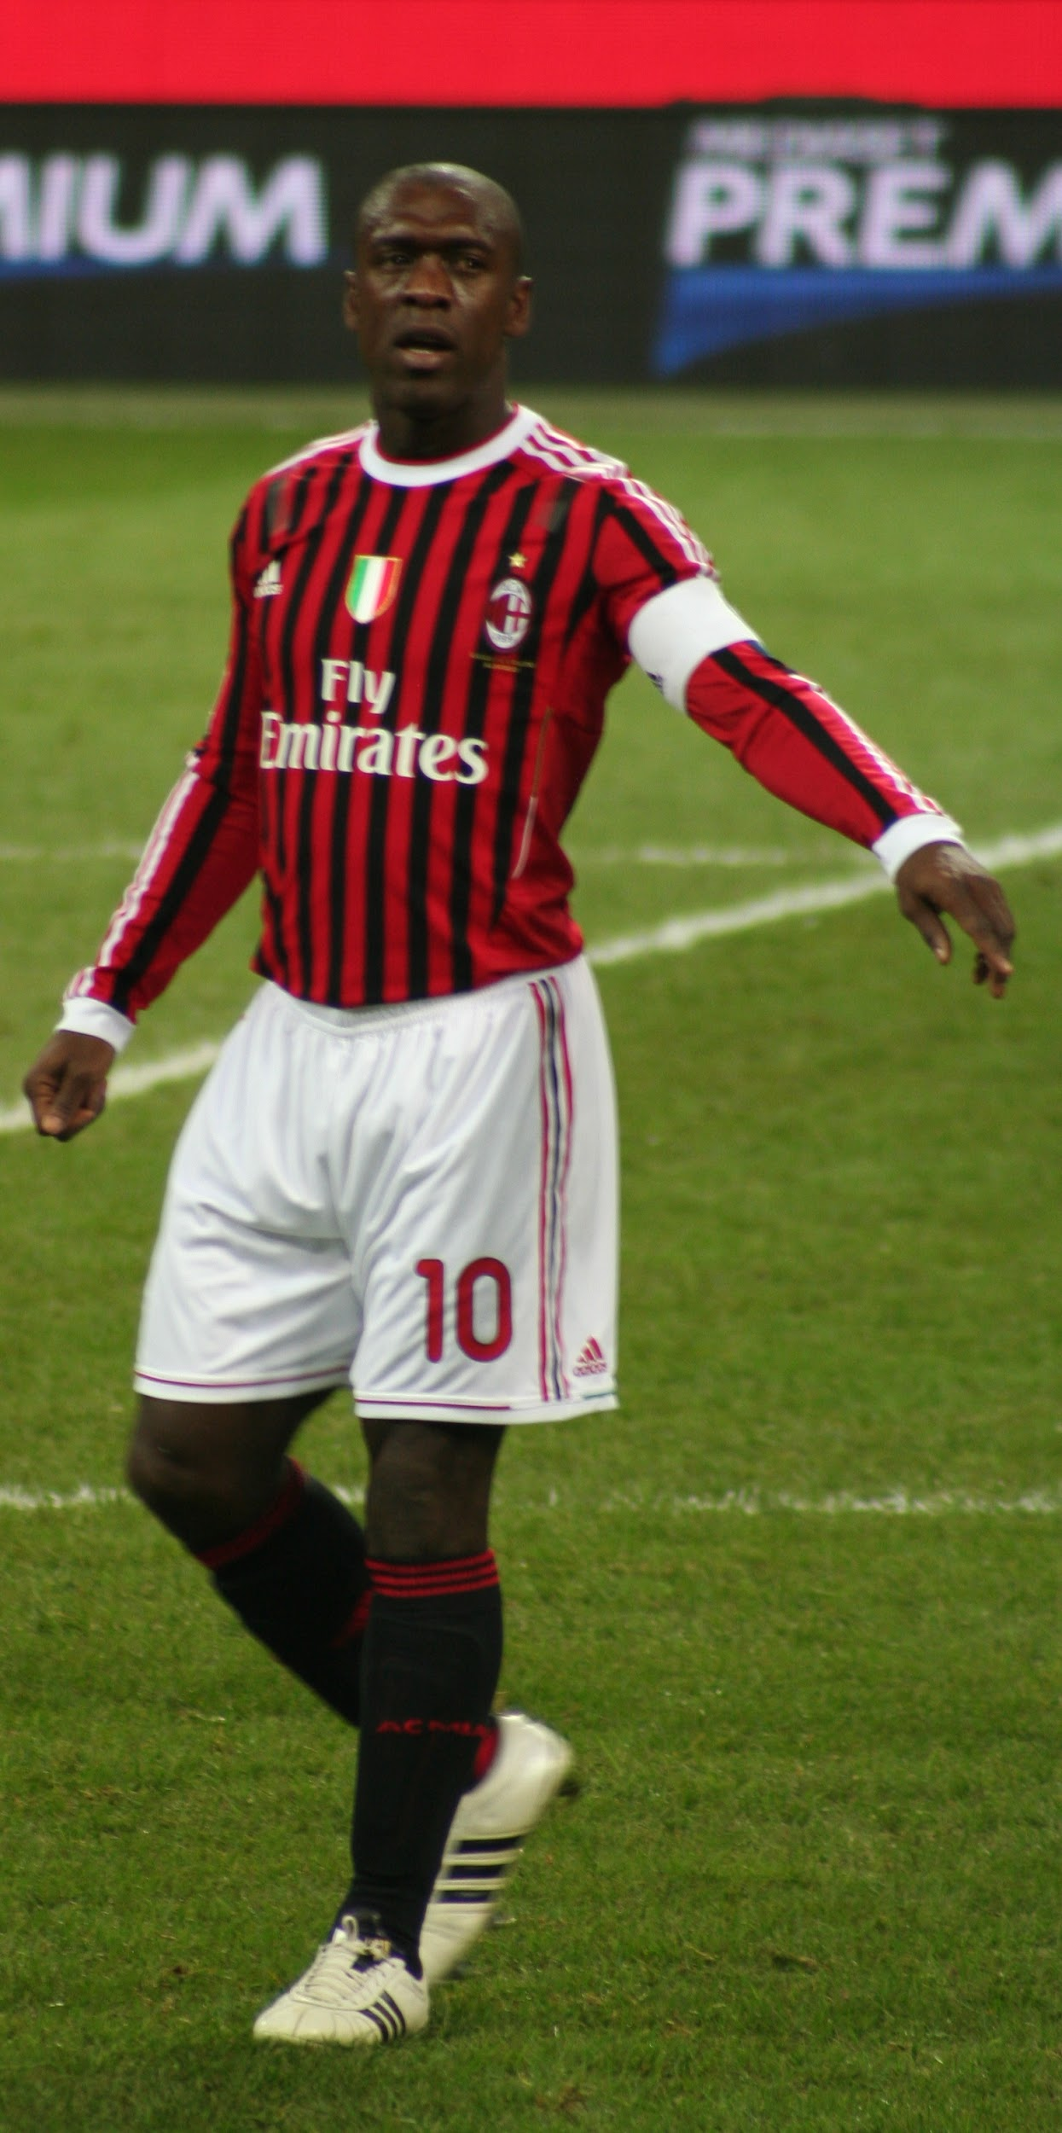
football
created by : kyan, dean and thom

Slide 2
we are going to talk about
1.titel
2. inhoud
3. extension
4. uniform
5. top ten best football players
6. top ten best football clubs

Slide 3
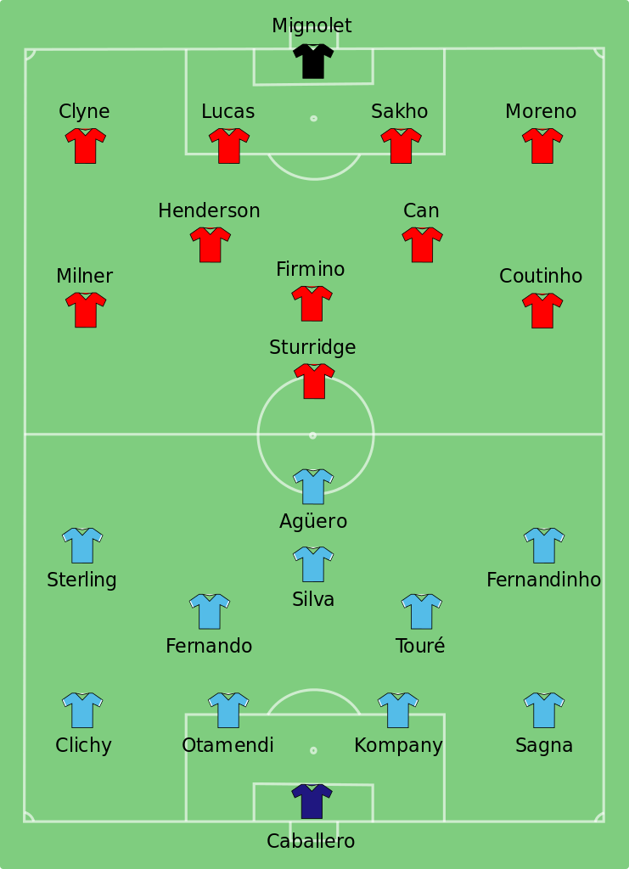
setup
1.keeper / opiekun / kalei / fylaka / coimeadai
2.defense / obrona / savunma / amyna / osaint
3.center field / srodkowe pole / merkez alan / kentriko pedio / larphairc
4.attack / atak / saldiri / epithesi / ionsai

Slide 4
extension
the extension is a time on a contest that in a draw ends and therefore there are 30 minutes played longer and they do that because someone has to win and someone has to lose.

Slide 5
uniform
soccer shoes / podosfairika papoutsia / broga sacair / futbol ayakkabilari / buty pilkarska
soccer socks / kaltses podosfairou / stocai sacair / futbol coraplari / skarpetki pilkarska
soccer pants / pants sacair / podosfairika pantelonia / futbol pantolonlari / spodnie pilkarska
soccer shirt / leine sacair / podosfairico poukamisco / futbal formasi / koszulka pilkarska

Slide 6
top ten best football players
10. ter stegen 9. modric
8. salah 7. van dijk
6. oblak 5. de bruyne
4. hazard 3. neymar jr.
2. ronaldo 1. messi

Slide 7
top ten best football clubs
10. manchester united 9. manchester city
8. bayern munchen 7. real madrid
6. paris saint- germain 5. chelsea
4. internazionale 3. juventus
2. barcelona 1. liverpool

Slide 8
quiz
who is the best football player of the world ?
what is the best football club of the world ?
how many minutes is there extension ?
what is our presentation about ?

Slide 9
answers
messi
liverpool
30 minutes

Slide 10
this is the end of our presentation !
Thank you for you attention

Slide 11
