Slide 1
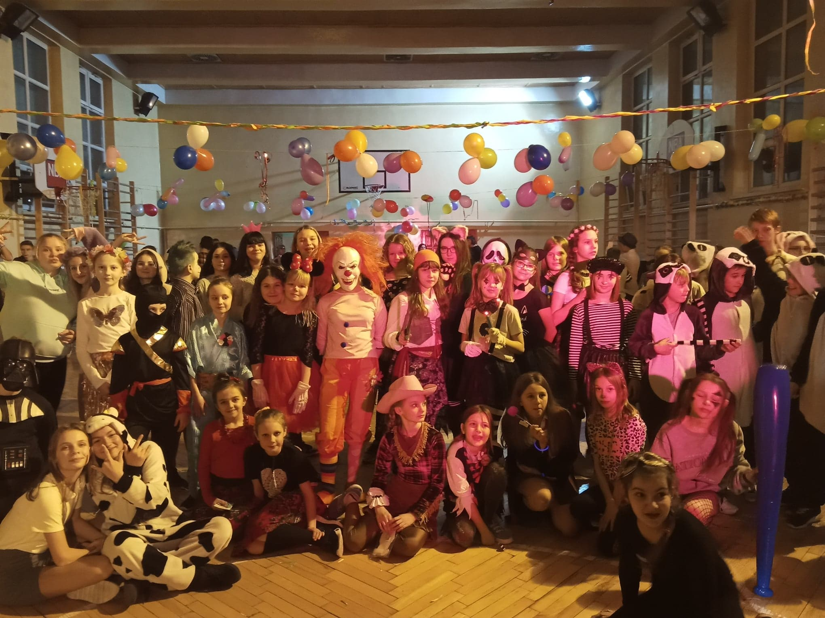
Carnival (6 JAN-25 FEB)

Slide 2
During this period, we have used to organize a costume party in our school every year - it is our tradition.
In 2020, the ball were organized 10 February.
The fancy dress party is organized by the Student Council.

Slide 3
It is a time of games, masquerades and great balls ...

Slide 4
In 2020, the ball began with a dance – Makarena, led by the school's principal:

Slide 5
Cotillion dance
is also a polish tradition - the party participant has to find a partner with the same cotillion, and then… dance one dance with him!

Slide 6
During the balls, we also have various competitions, for example:
the best disguise competition, dance competition and drawing of a ‘lucky number’.

Slide 7
Check out the fun we had!

Slide 8
Check out the fun we had!

