Slide 1
johannes vermeer
Weijerwereld group 7

Slide 2
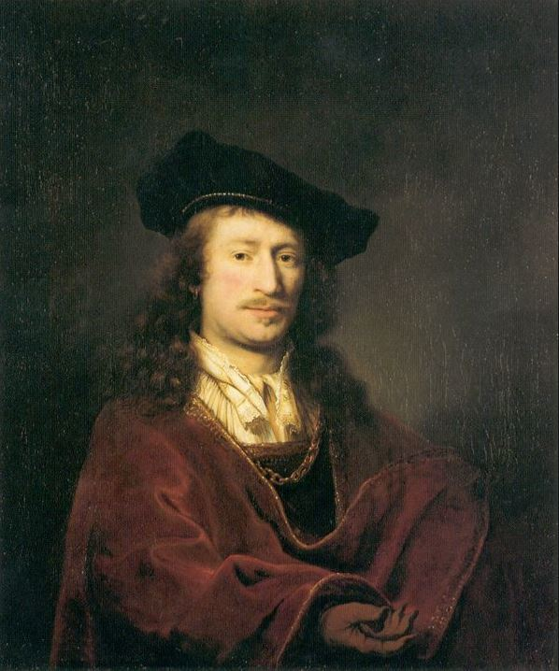
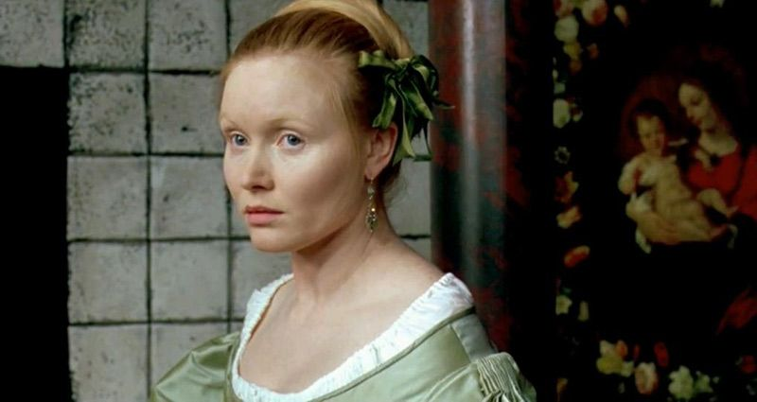
explanation johannes vermeer and his female
He is born in 31 october 1632-1675 15 december,and he was 43 years old. He was born in Delft. He was baptized on 31 october 1632 in the new church, and he was marry on 21 years old with Catharina Bolnes (his wife), and she was 1631-1687 30 december, and she was 56 years old.
:this is he and this is her:

Slide 3
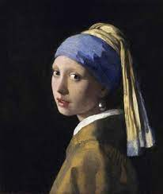
this is his famous portait:
The portait was made on 1665-1667. He is $7,8 million thats so much monney!!!The name of his portait its: girl with the pearl.

Slide 4
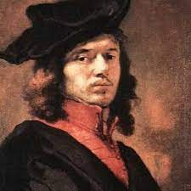
end

