Slide 1
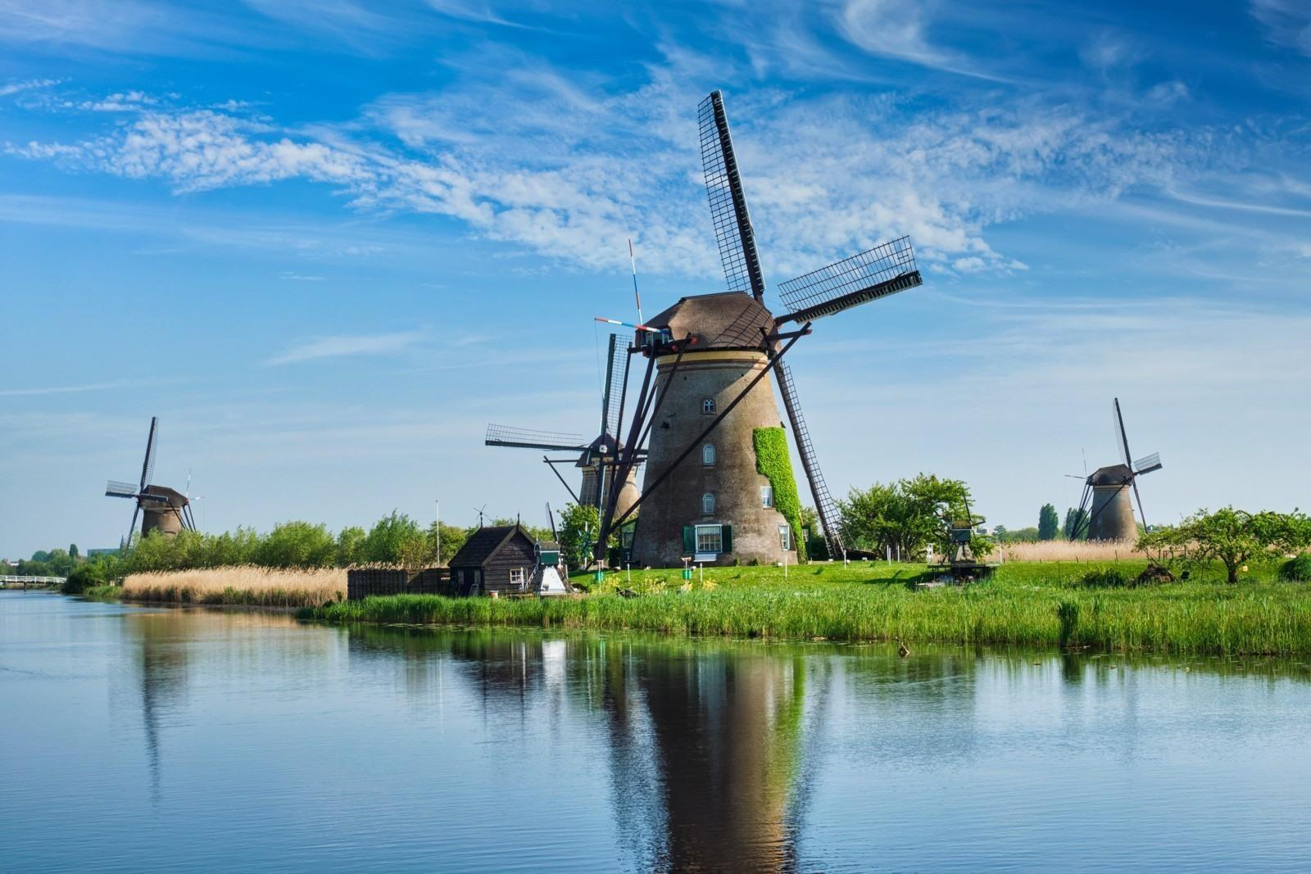
Kinderdijk

Slide 2
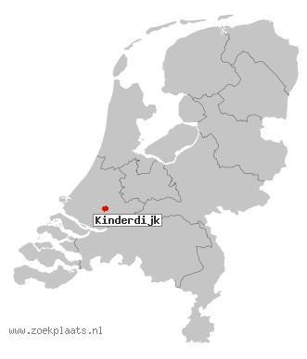
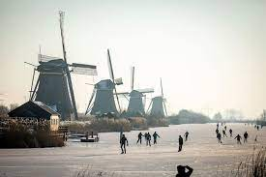
Information about Kinderdijk
Kinderdijk is located in the provence of South-Holland.
Kinderdijk is located at the place where the rivers the Noord and the Lek come together. The place is famous for the mills.
The first eight mills were build in 1738. Two years later in 1740 eight more mills were build. In total there are 19 mills.
Kinderdijk was the first Dutch town with an electricity supply.

Slide 3
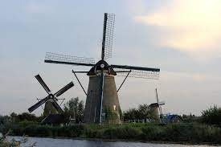
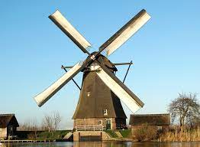
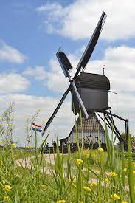
The mills of Kinderdijk
The mills in Kinderdijk are UNESCO world heritage since 1997.
The 19 mills are divided in a row of 8 mills on the Nederwaard (round, stone mills), a row of 8 thatched octagons mills on the Overwaard, with a seesaw mill next to it, the Blokweerse mill that drains the Blokweer polder and two thatched octagonal mills in the Nieuw-Lekkerland polder.

