Slide 1
Manos Hatzidakis

Slide 2
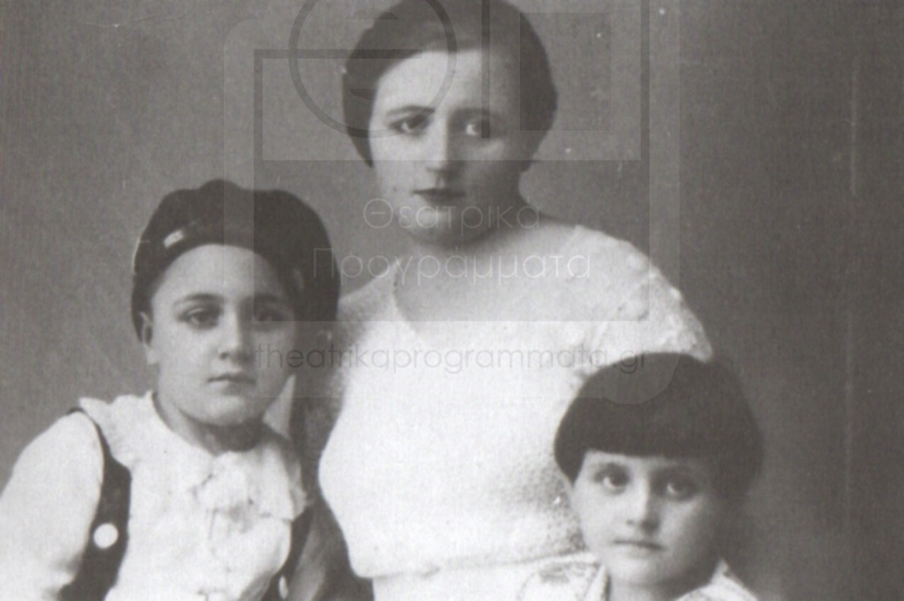
Biography
He was born in Xanthi at 23rd of October 1925 . His family was living there because his father was working as a lawyer in a tobacco industry.

Slide 3
College
His musical education started at the age of 4 and it included piano lessons.
At the same time he was practicing in the violin and at the accordion.He never completed his studies. The young Hatzidakis worked for his living as unloader at the port, ice vendor, a clerk at a photo studio and assistant nurse at a military hospital.

Slide 4
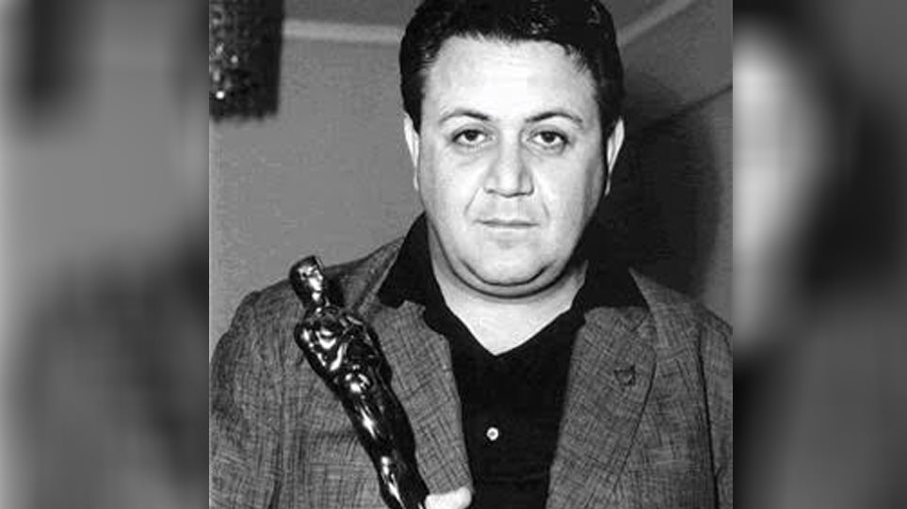
His work
Since 1950 he was been writing music for ancient tragedies and comedies. The music he composed for great films of Greek and international cinema are also a big chapter. In 1960 he won the Oscar for the song ‘The children of Piraeus’ from Jill Dassen’s film ‘Never on Sunday’

Slide 5
His projects
During all these years, Manos Hatzidakis is constantly present in the Greek discography, with dozens of records that are now considered classics. The circle with Chalk 1956,A tale without a Name 1959, Lilacs Through the dead land 1961 ,Fifteen Vespers 1964, Mythology 1965, Captain Michael 1966,The Absurd 1975, The dark mother 1985 The song of Sin 1992
Unique, genius and immovable Manos Hatzidakis left from us on June 15, 1994.

