Slide 1
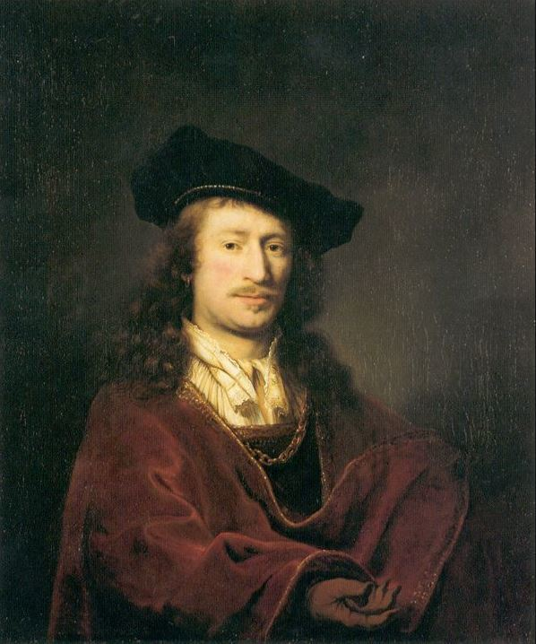
presentation Johannes Vermeer
Milan van dijk
jayden van kuijk

Slide 2
Hello we to be Jayden and Milan
we are going to tell you about Johannes Vermeer
nickname clicko jayjay

Slide 3
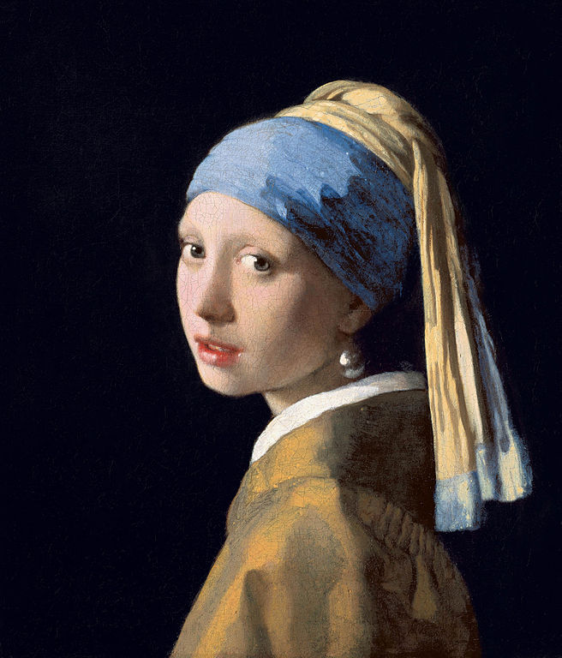
Johannes Vanmeer information
johannes vermeer is born in Delft burial in old church
in december 1675 tu bury in oude kerk
married with Catharina Bolnes
girl with the pearl

Slide 4
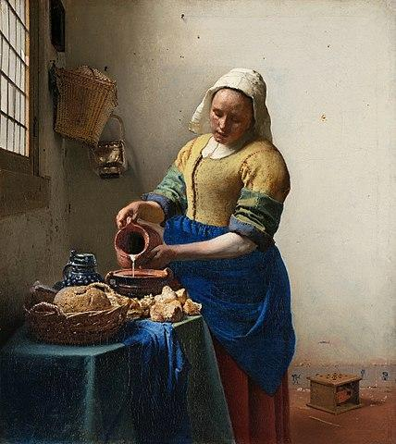
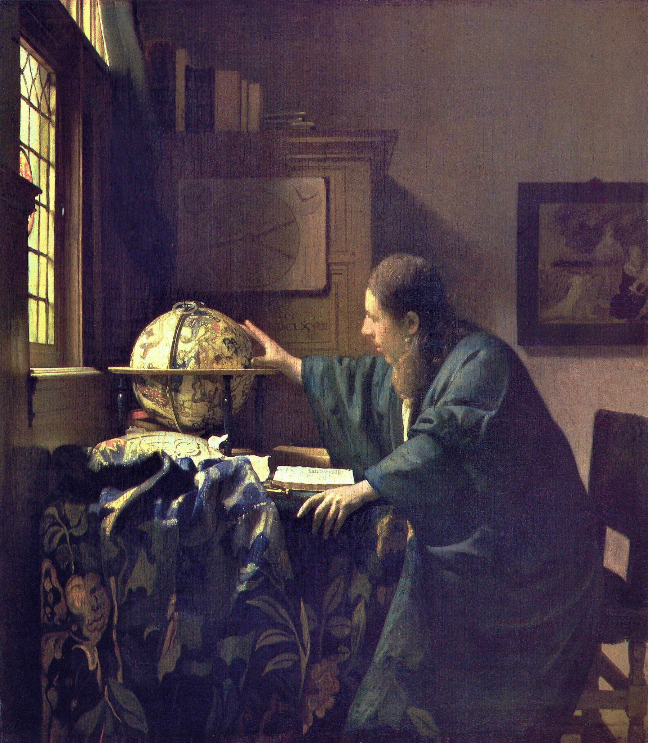
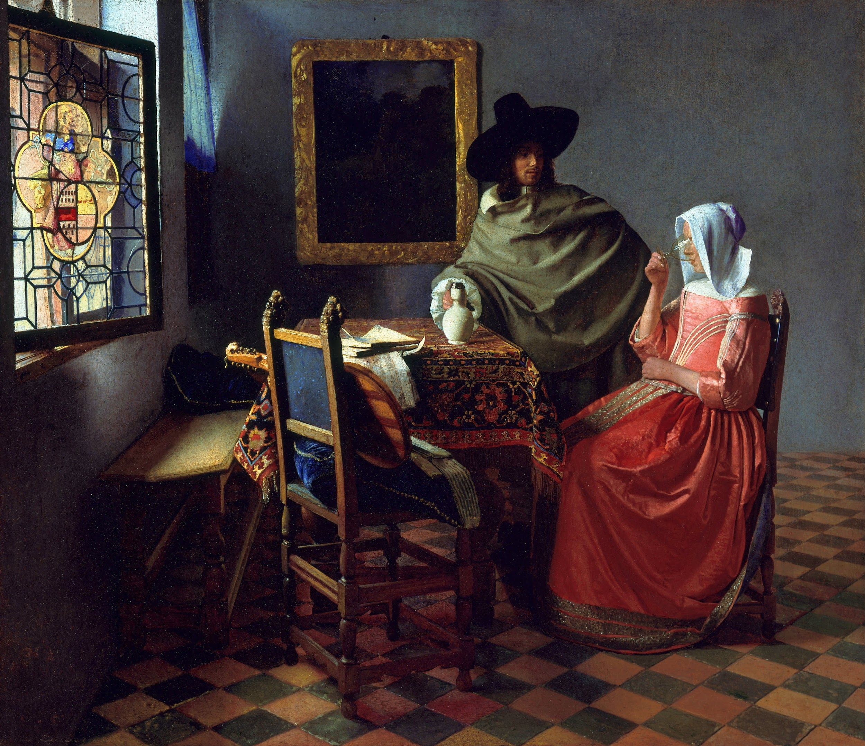
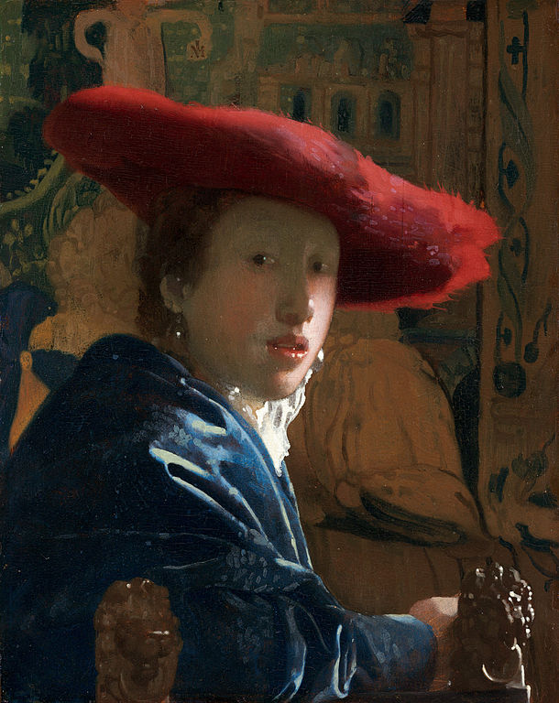
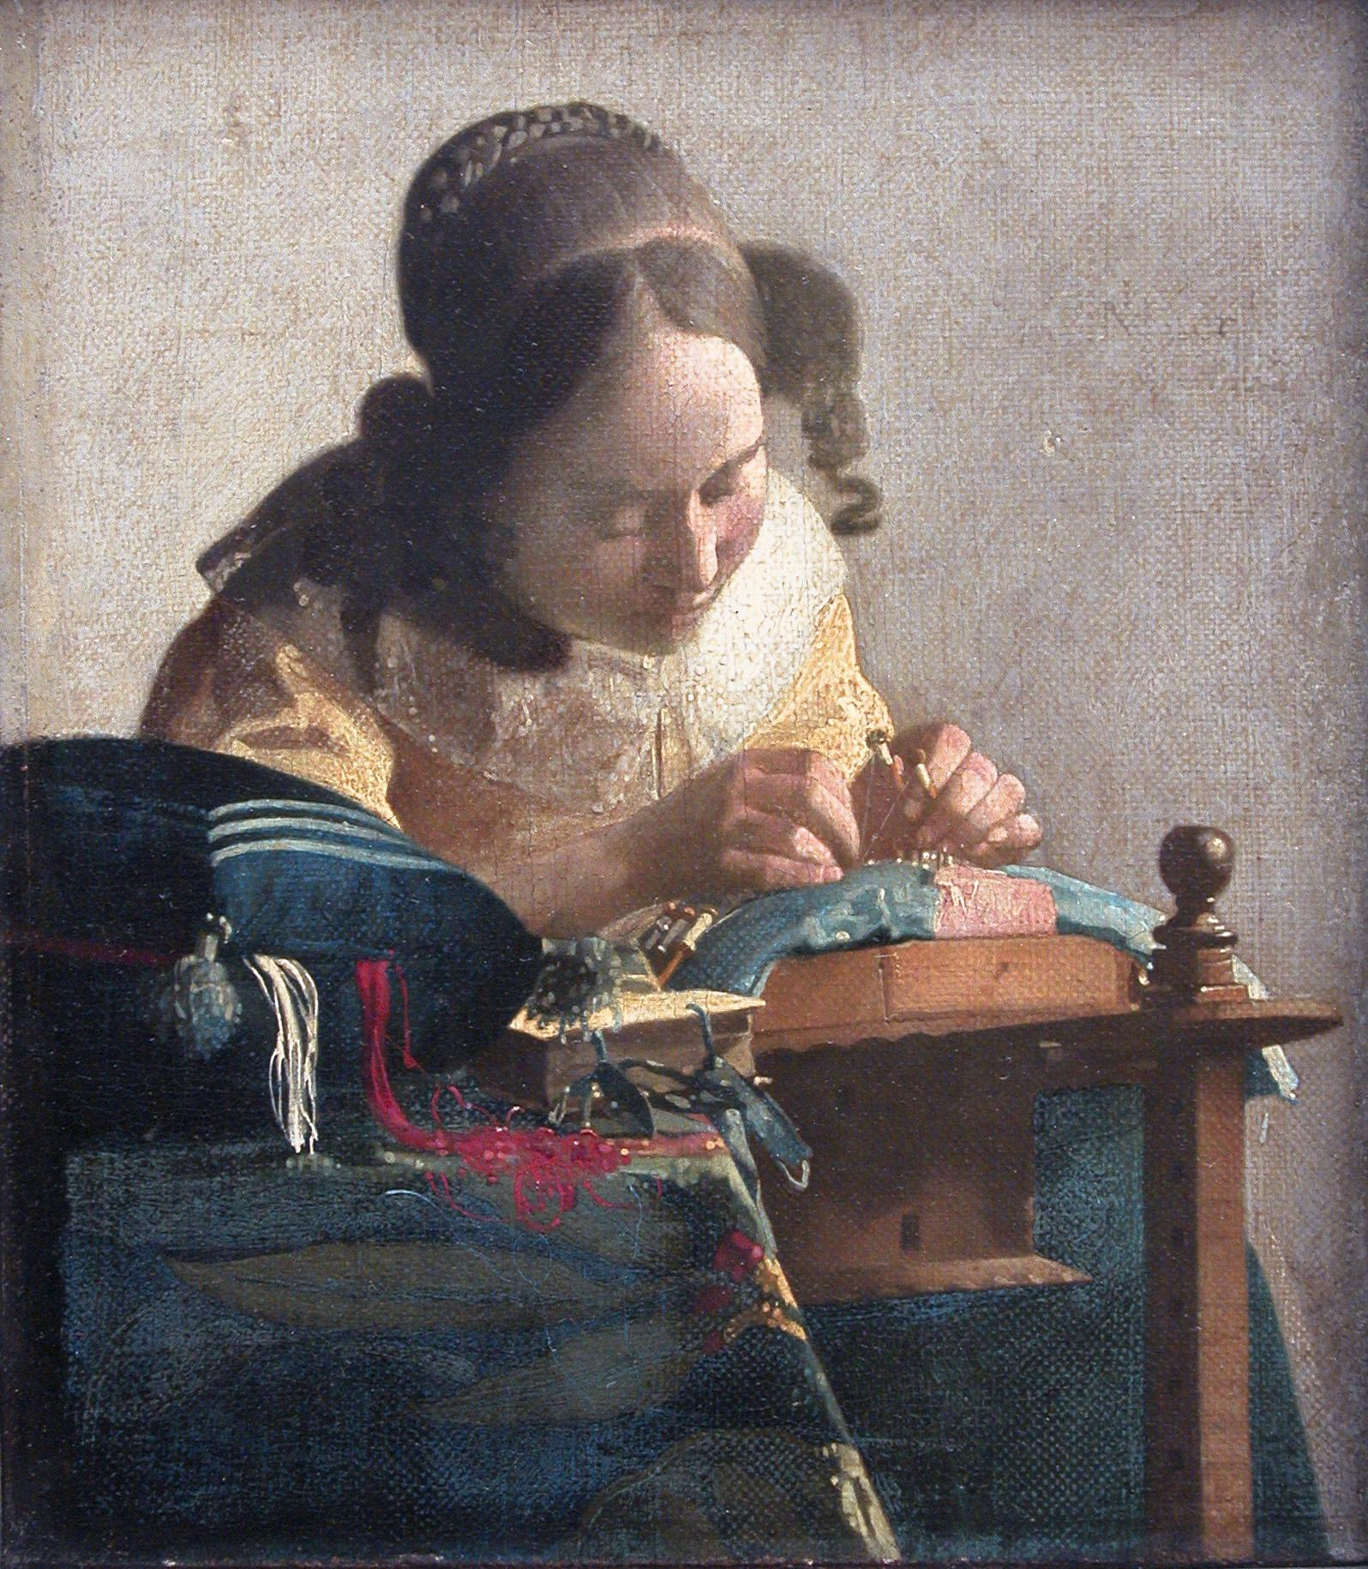

Slide 5
famous paitings
milk girl
self portrait by johannes vermeer

