Slide 1
Rembrandt van Rijn
Saar en Wessel

Slide 2
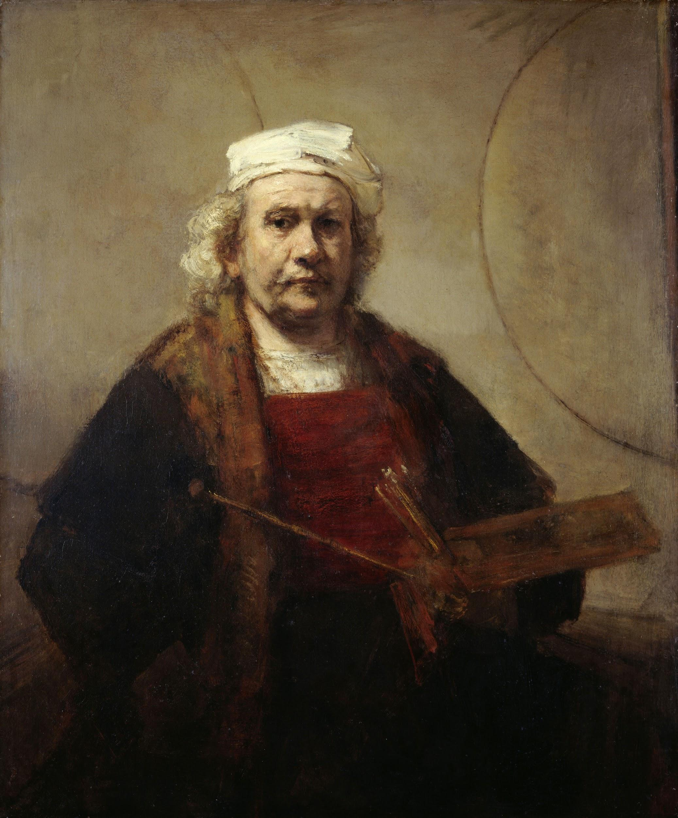
Rembrandt
Did you know his real name Rembrandt Harmenszoon van rijn is?
In addition to being a painter,he also a etcher.
He was born on 15 July 1606
He died in 4 october 1669

Slide 3
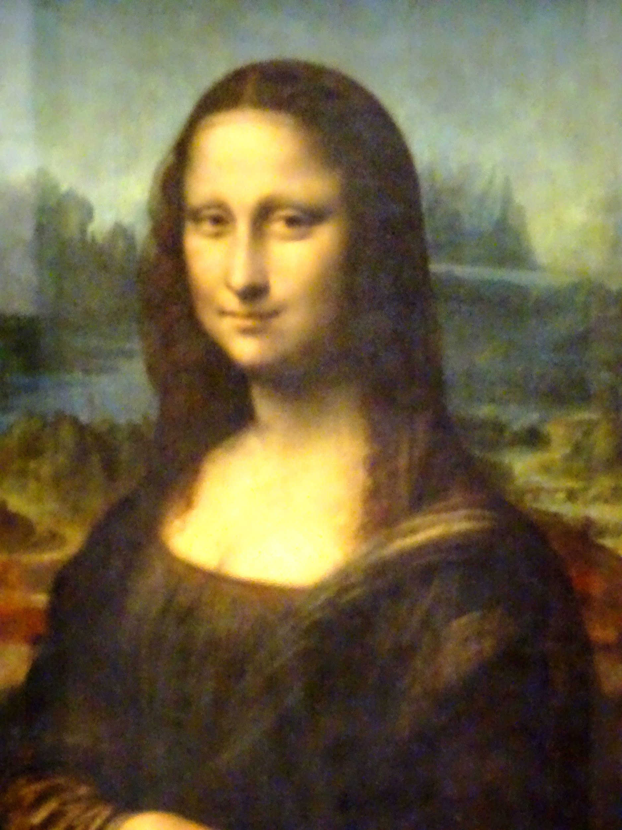
Paintings
He paint 300 paintings
And also he was painter and etcher of the golden age
And he was the most important dutch master in the 17th century

Slide 4
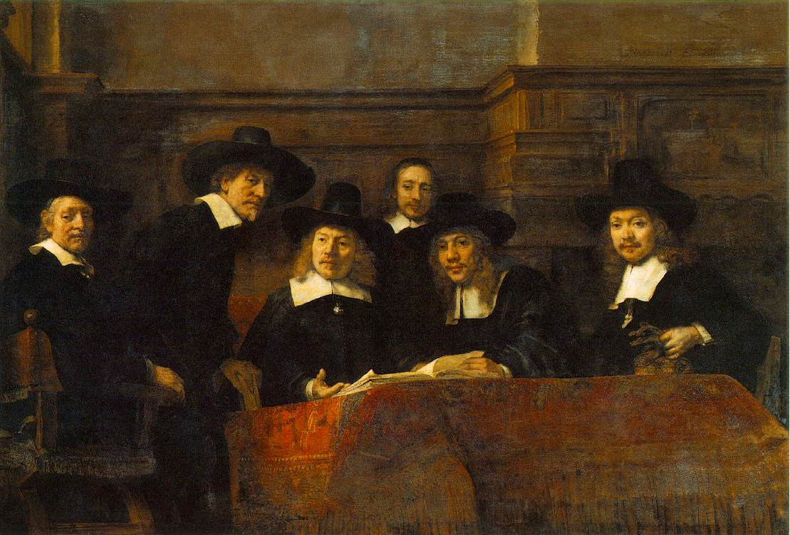
Were rembrandts parents rich or no
Rembrandt his parents were certainly not rich but also not poor

Slide 5
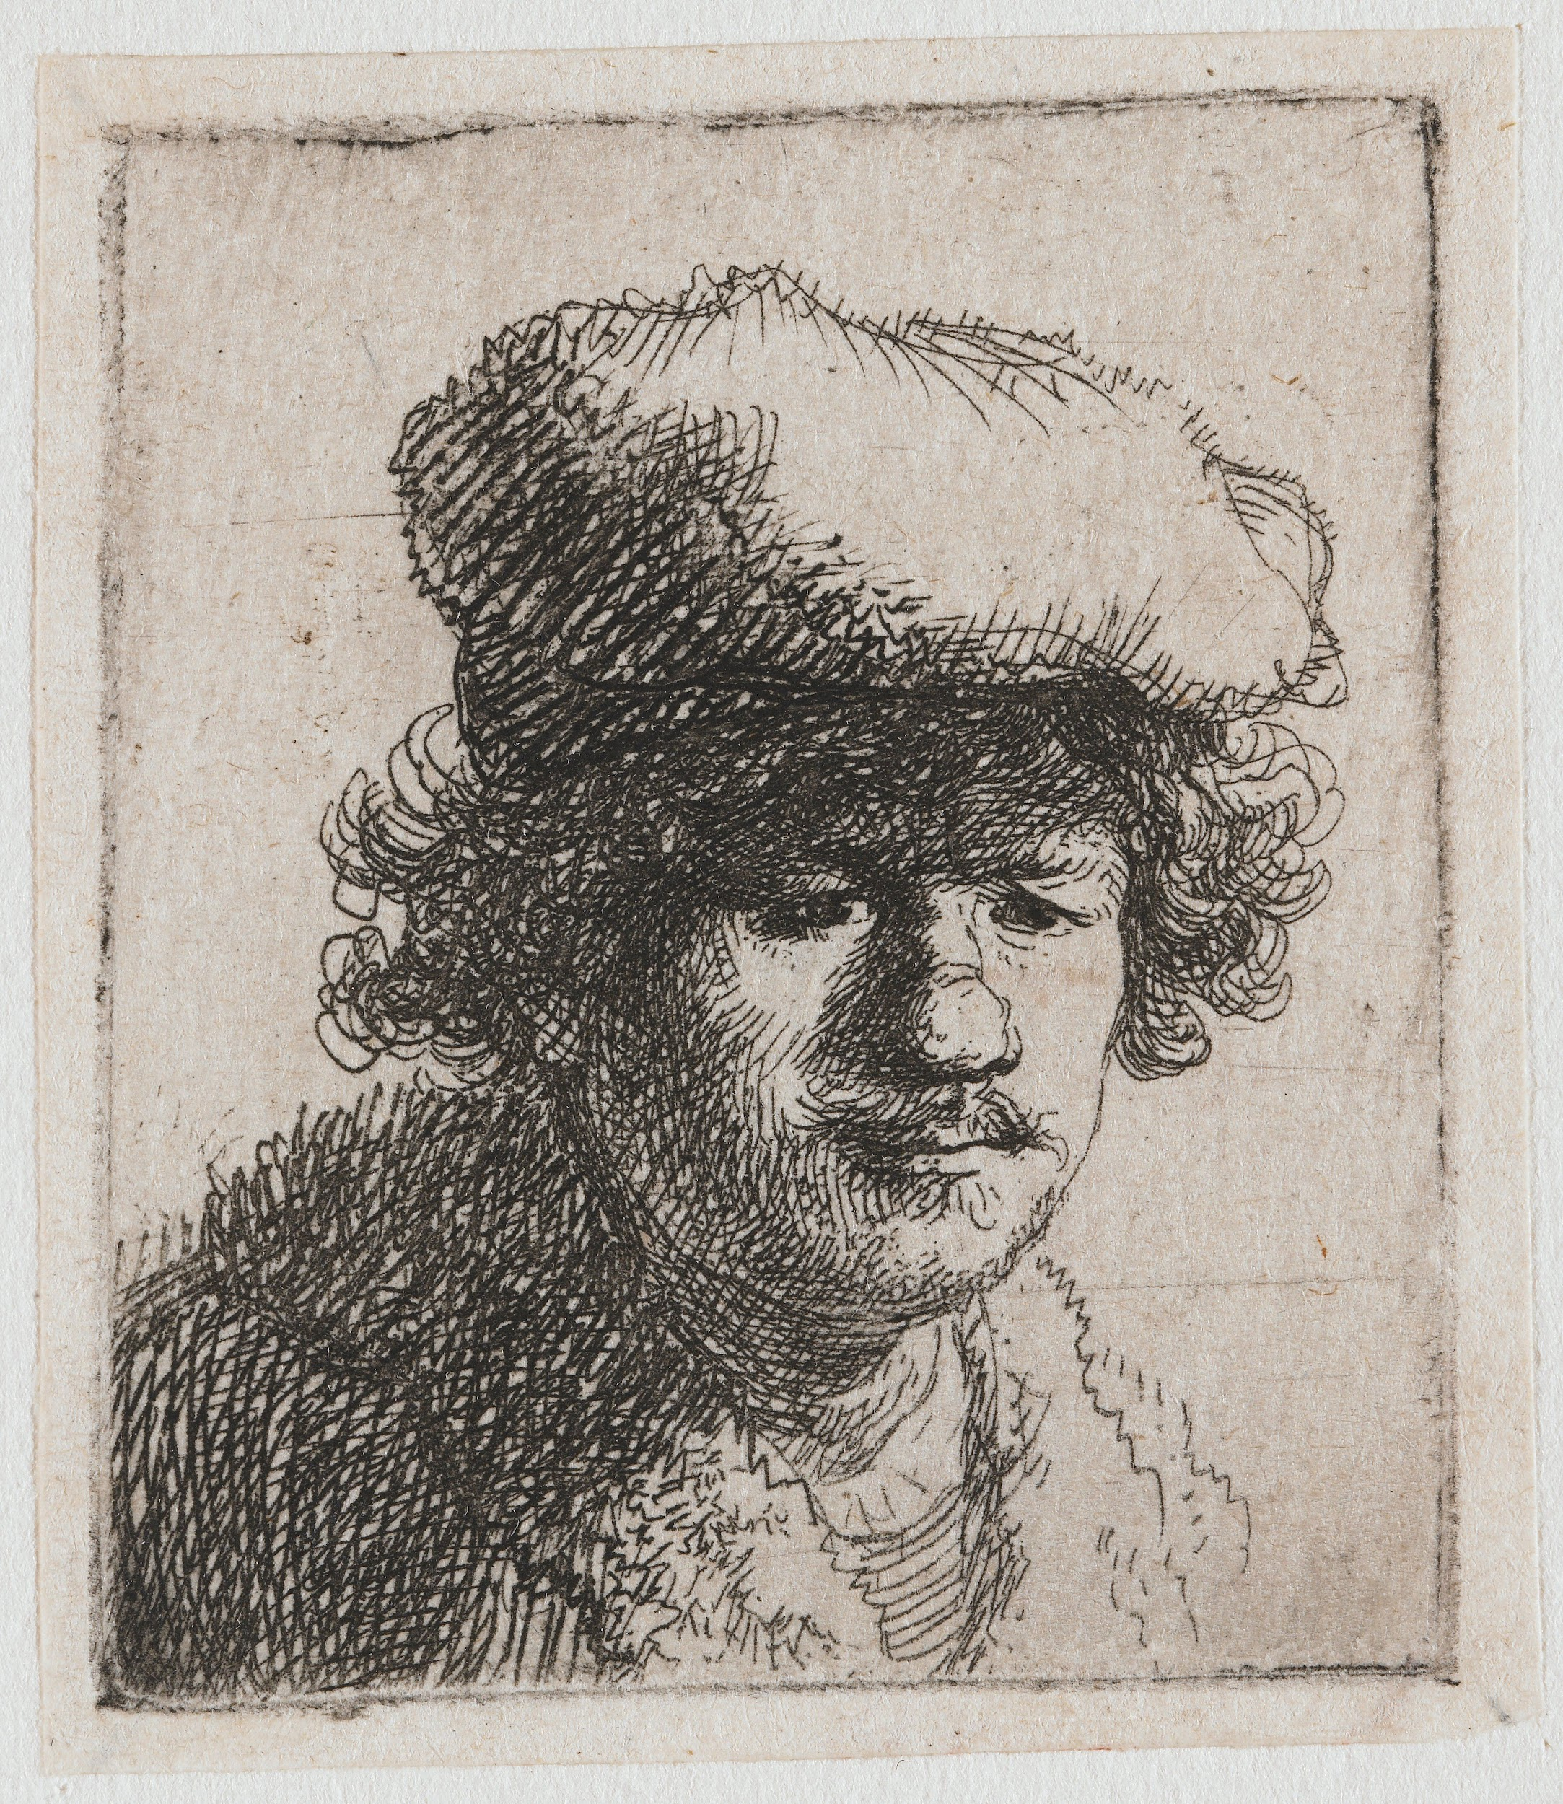
A fact
Do you know that there is a ice cream parlor and a chocolate shop that called rembrandt?
That´s because make a work of art from
te chocolate.

Slide 6
the end

