Slide 1
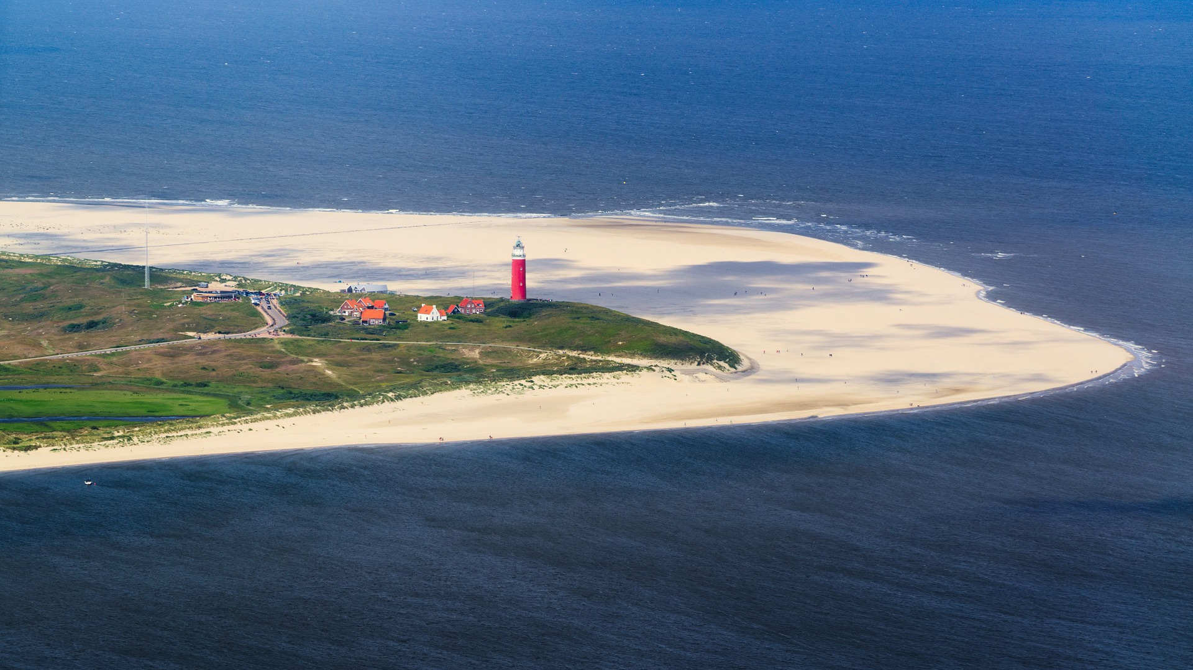
The Waddeneilanden and watermanagement

Slide 2
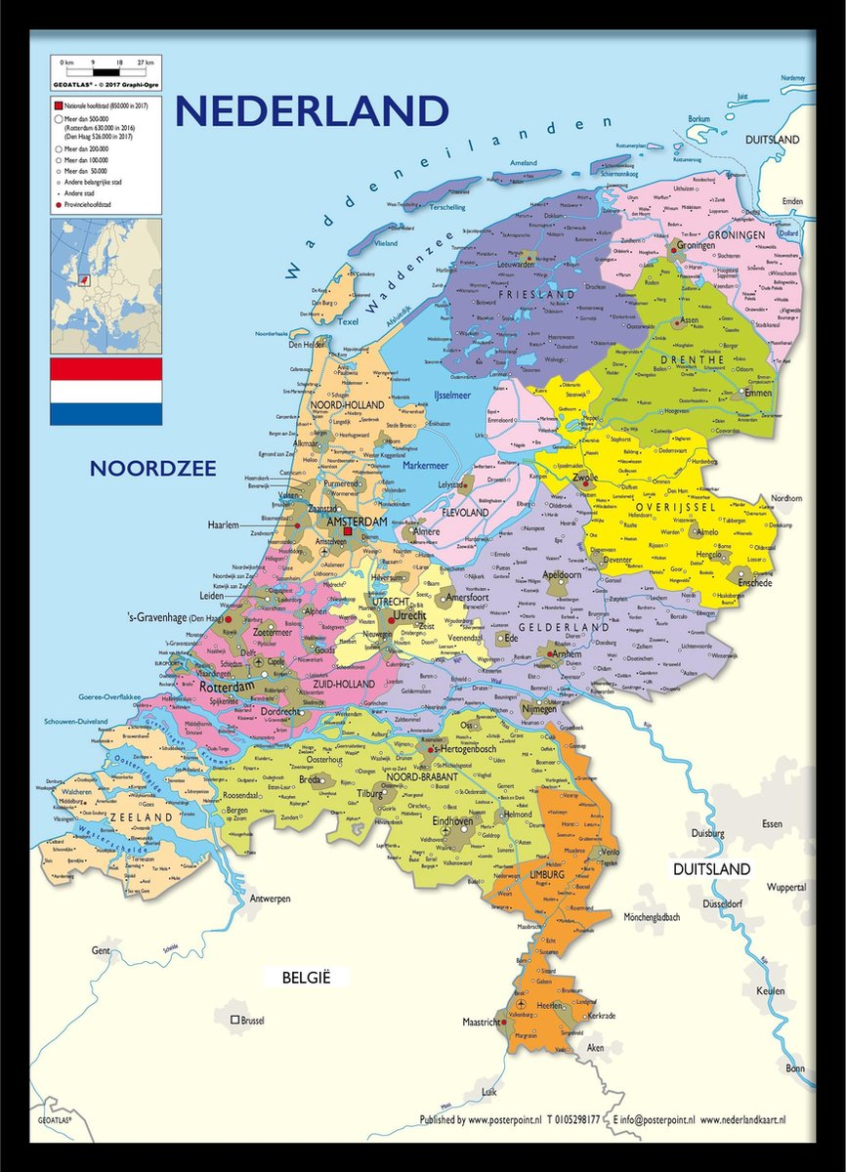
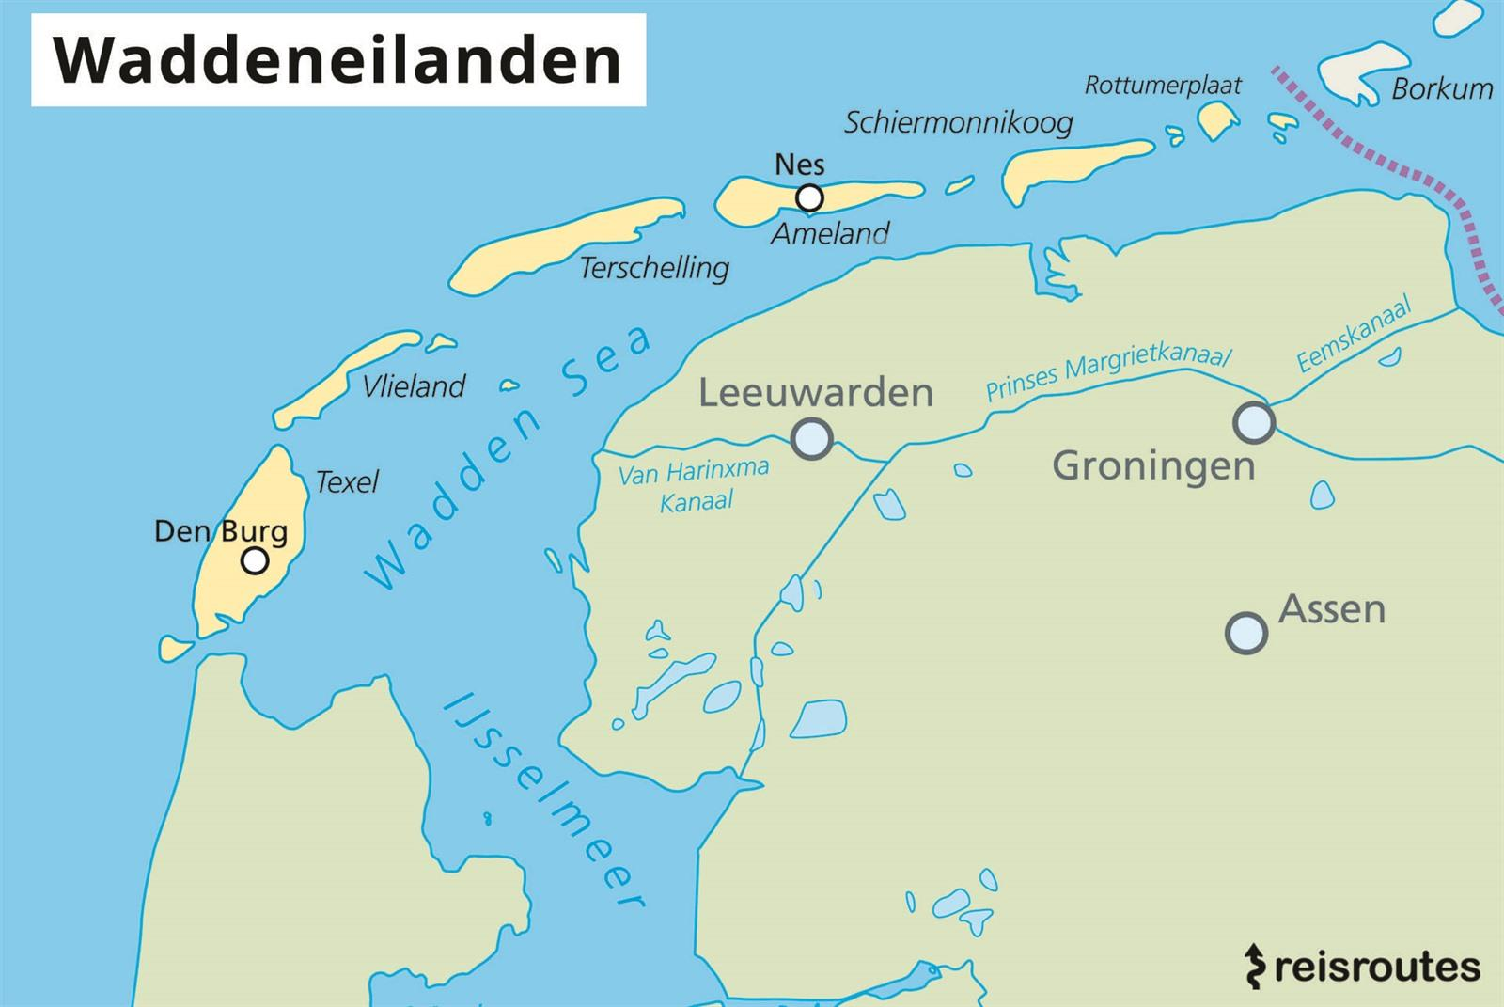
The Waddeneilanden
There are five Dutch islands.
Texel, Vlieland, Terschelling, Ameland and Schiermonnikoog.
They are located in the North sea, in the north of the Netherlands. In between the main land and the islands is the Waddenzee.
The Dutch islands have an area of 405.2 km² and they have 24504 inhabitants.

Slide 3
Texel
The first island is Texel. The biggest place is Den Burg.
It is the biggest island of the five.
It belongs to the provence of North-Holland.
The length of Texel is 20 kilometers and the average width is 8 kilometers.
There are 13547 inhabitants on Texel.
Cool places to visit are Ecomare (they have seals there), the lighthouse and the national park.

Slide 4
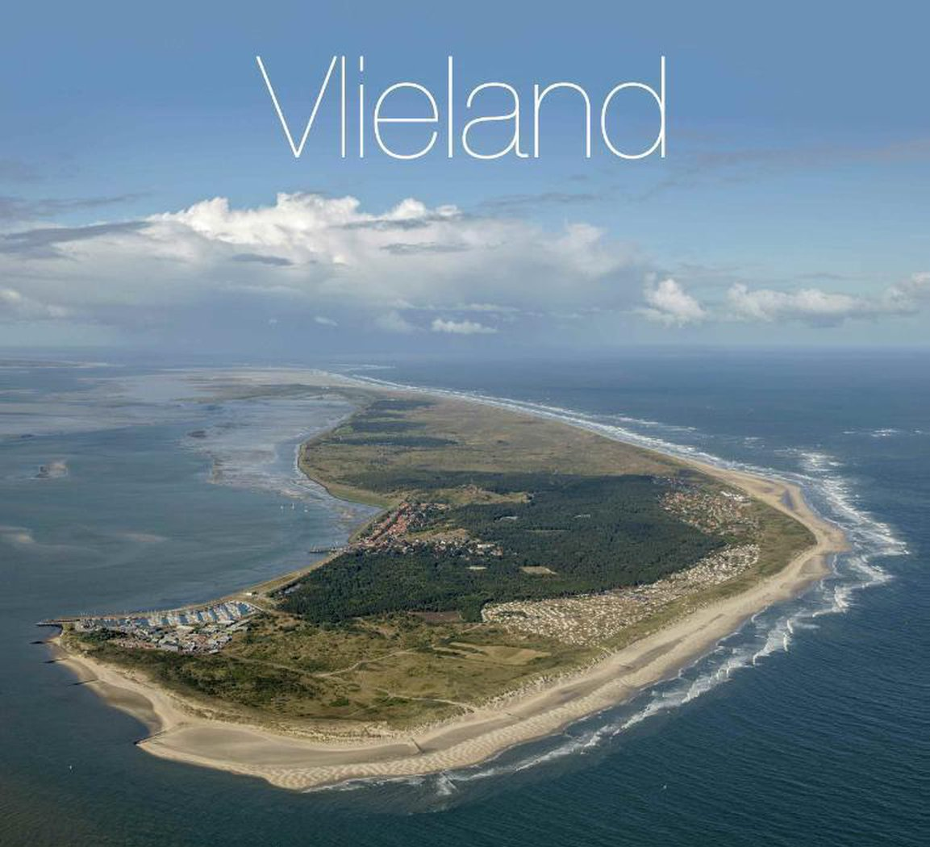
Vlieland
Vlieland is the second island.
There is only one village on Vlieland, Osteynde.
They have about 1000 inhabitants on Vlieland.
Vlieland is mostly nature, with lots of dunes, beaches and forest.
The island is very clean.
You can get there by ferry from Harlingen.

Slide 5
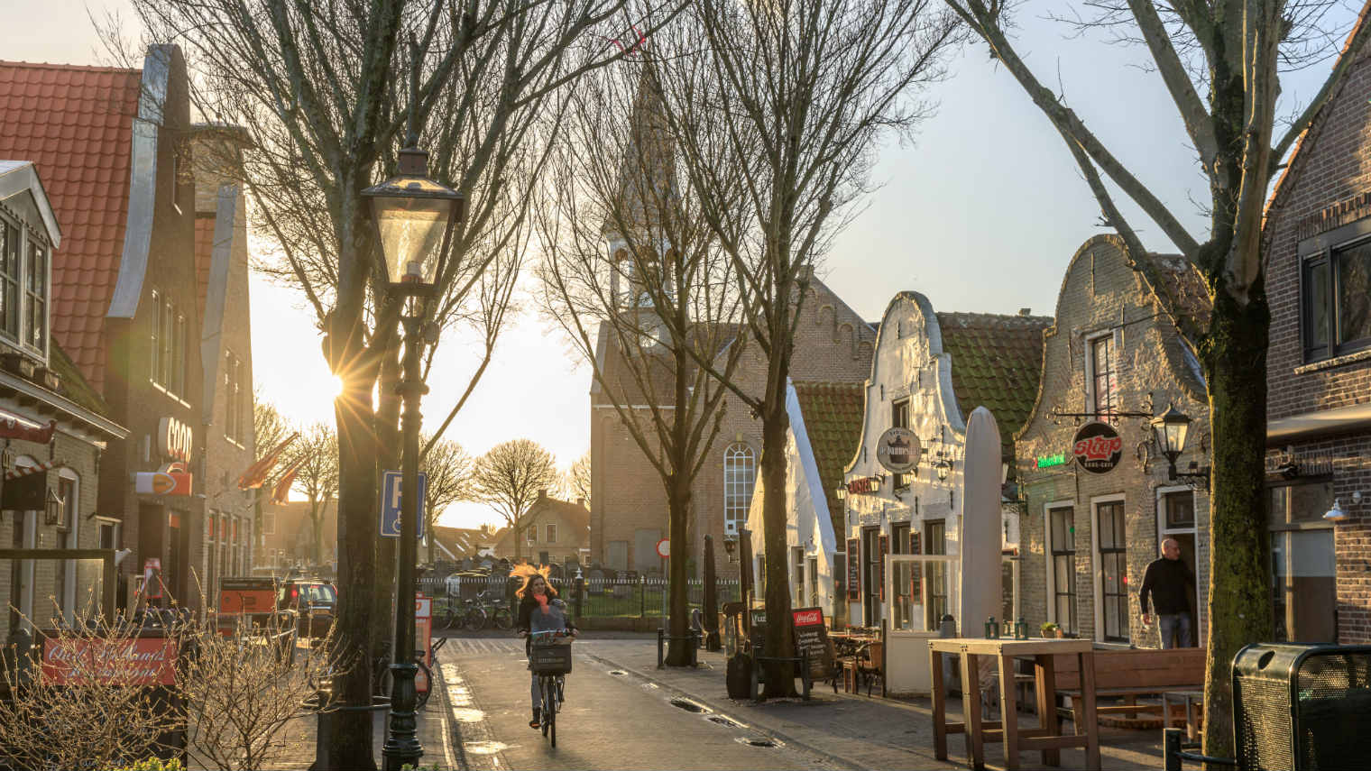
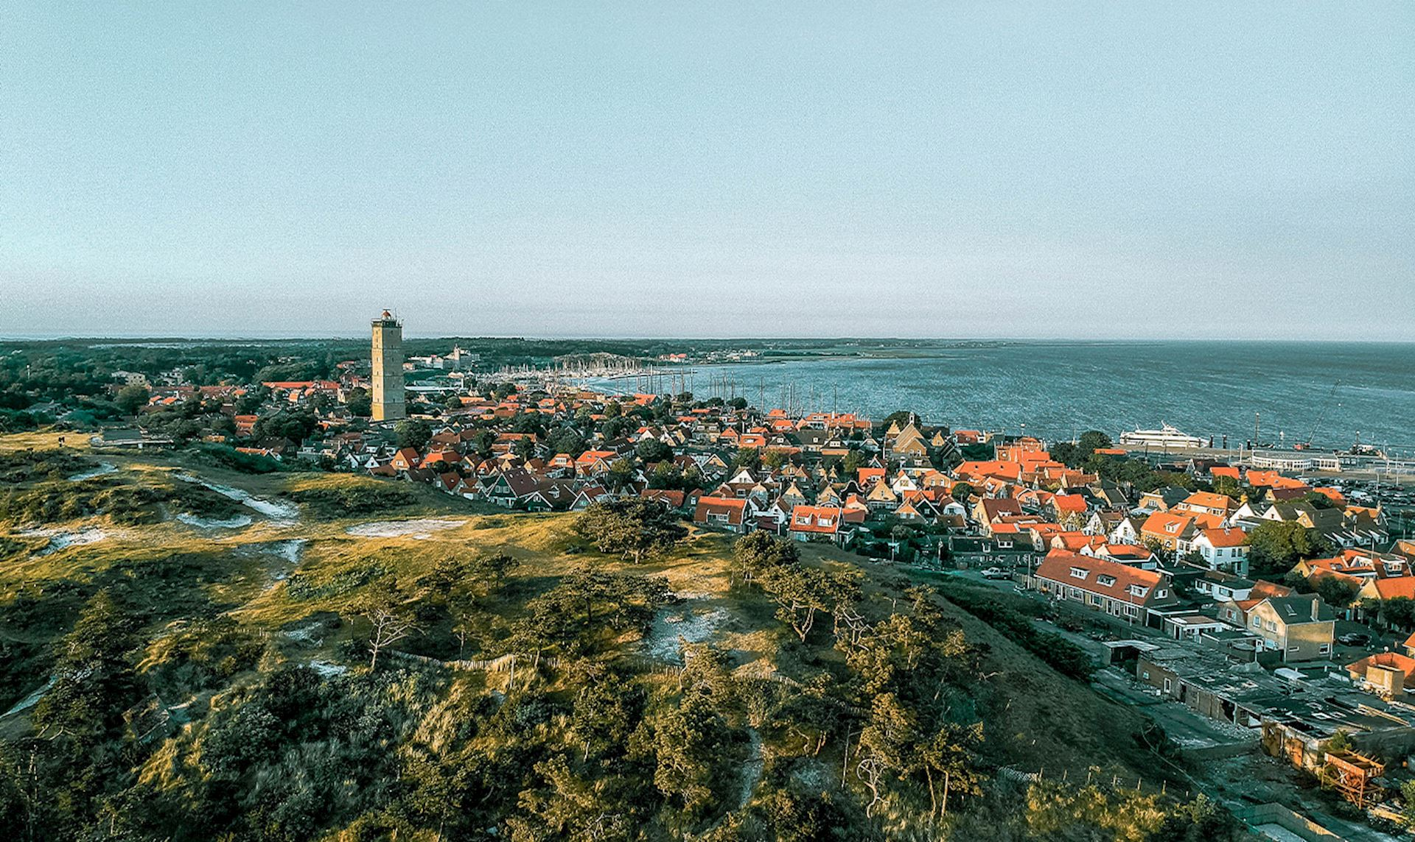
Terschelling
Terschelling is the thirth island.
Terschelling is located in the provence of Friesland, however untill 1942 it belonged to North-Holland.
There are 4890 inhabitants.
Terschelling is the middle island.
The three main things in Terschelling are nature, tourism and the sea.

Slide 6
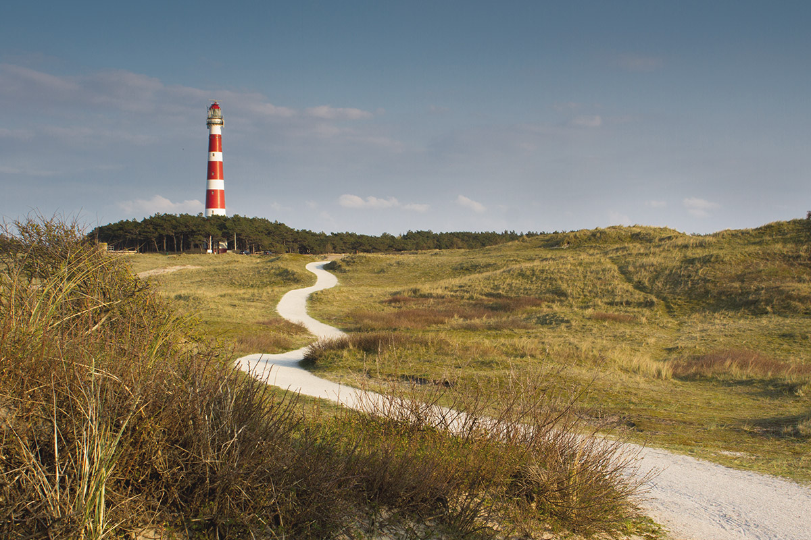
Ameland
Ameland is the fourth island.
It belongs to the provence of Friesland.
There are 3743 inhabitants.
The lenght of Ameland is 25 kilometers and the maximum width is 5 kilometers.
The place is loved by artists for it’s beatiful nature and the beautiful light.

Slide 7
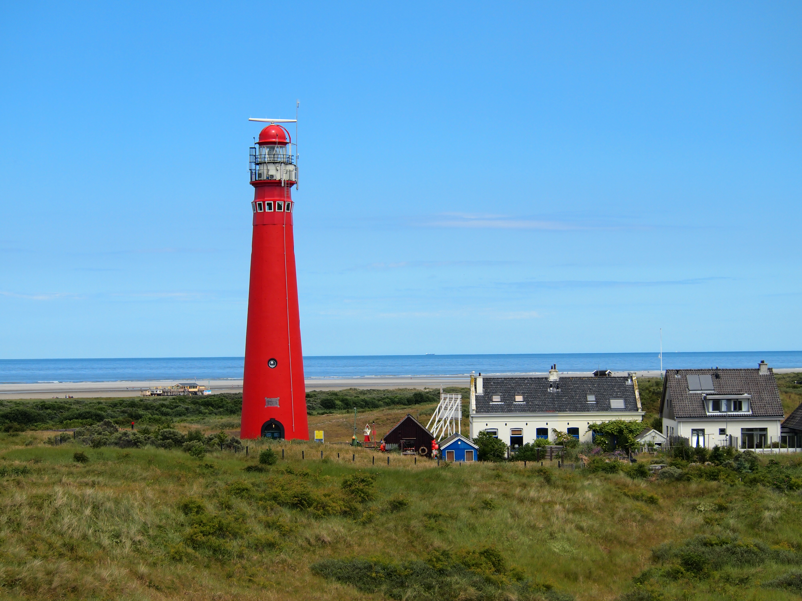
Schiermonnikoog
The fifth island is Schiermonnikoog, it also belongs to the provence of Friesland.
There are 943 inhabitants.
It is the smallest amount of inhabitants in a township.
The highest dunetop is 20 metres.
The main income comes from tourism.
There are no cars allowed on the island.

Slide 8
Watermanagement in the Netherlands
Because the Netherlands is located below sea level, we need to have a good watermanagement.
Back in 1953 there was an overflow, called the watersnoodramp. After that the Netherlands invested in better dykes and watermanagement.
60 percent of the Netherlands are vunareble for the water when the dykes break.
We have 3.700 kilometers of protection (dykes, dunes, dams and weirs).

Slide 9
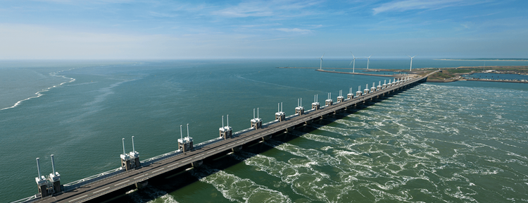
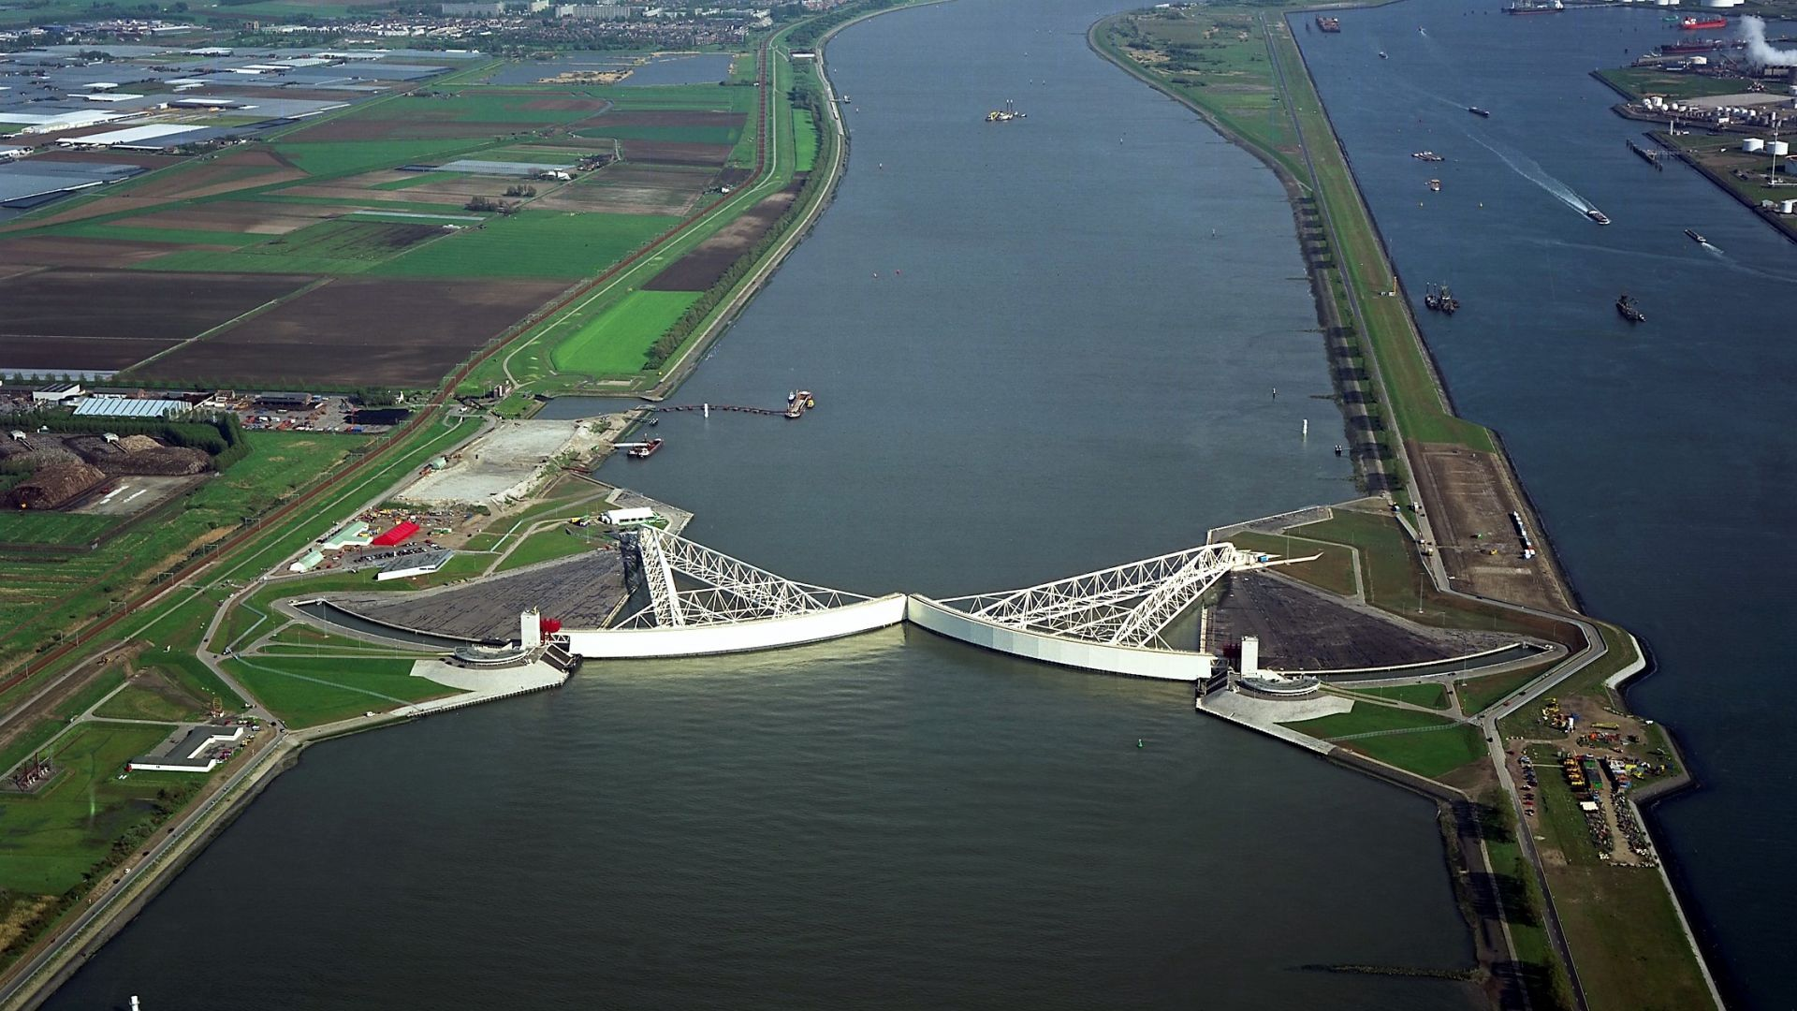
Famous waterworks
The most famous waterworks are the Deltaworks. It is the largest defense system against high water from the sea. These flood defenses consist of 5 storm surge barriers, 2 locks and 6 dams.
In 1997 the Deltaworks were finished.
https://www.youtube.com/watch?v=QCnwzHqSvdE

